Slide 1





14 - 16 NOVEMBER 2023
RIYADH, SAUDI ARABIA
A SPECIALIZED DNS SERVER FOR PENETRATION TESTING AND VULNERABILITY RESEARCH
IVAN JEDEK
ORGANISED BY:
IN ASSOCIATION WITH:

Slide 2

AGENDA
Story behind
DNS servers 101 and pentesting strategies
intro: DNS server for vulnerability research and pentesting
deployment, features and usage examples
Implementing new features in
Conclusion

Slide 3

IVAN JEDEK
Senior Security Researcher at OryxLabs Technologies (UAE)
Past:
RED : Penetration tester / red teamer / consultant
BLUE : Malware analyst / reverse engineer (asm/x86)
OSCP, OSCE
www.infosecmatter.com
github.com/InfosecMatter

Slide 4
STORY BEHIND

Slide 5

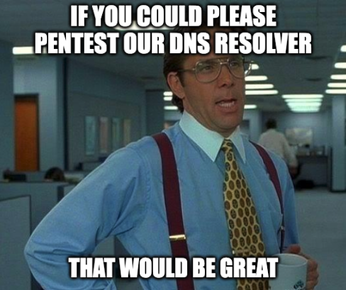
IF YOU COULD PLEASE PENTEST OUR DNS RESOLVER
THAT WOULD BE GREAT

Slide 6

OK SIR

Slide 7

ONE DOES NOT SIMPLY
SAY “NO”

Slide 8
HOW DO YOU PENTEST A DNS RESOLVER?

Slide 9
WHAT EXACTLY ARE DNS RESOLVERS?

Slide 10

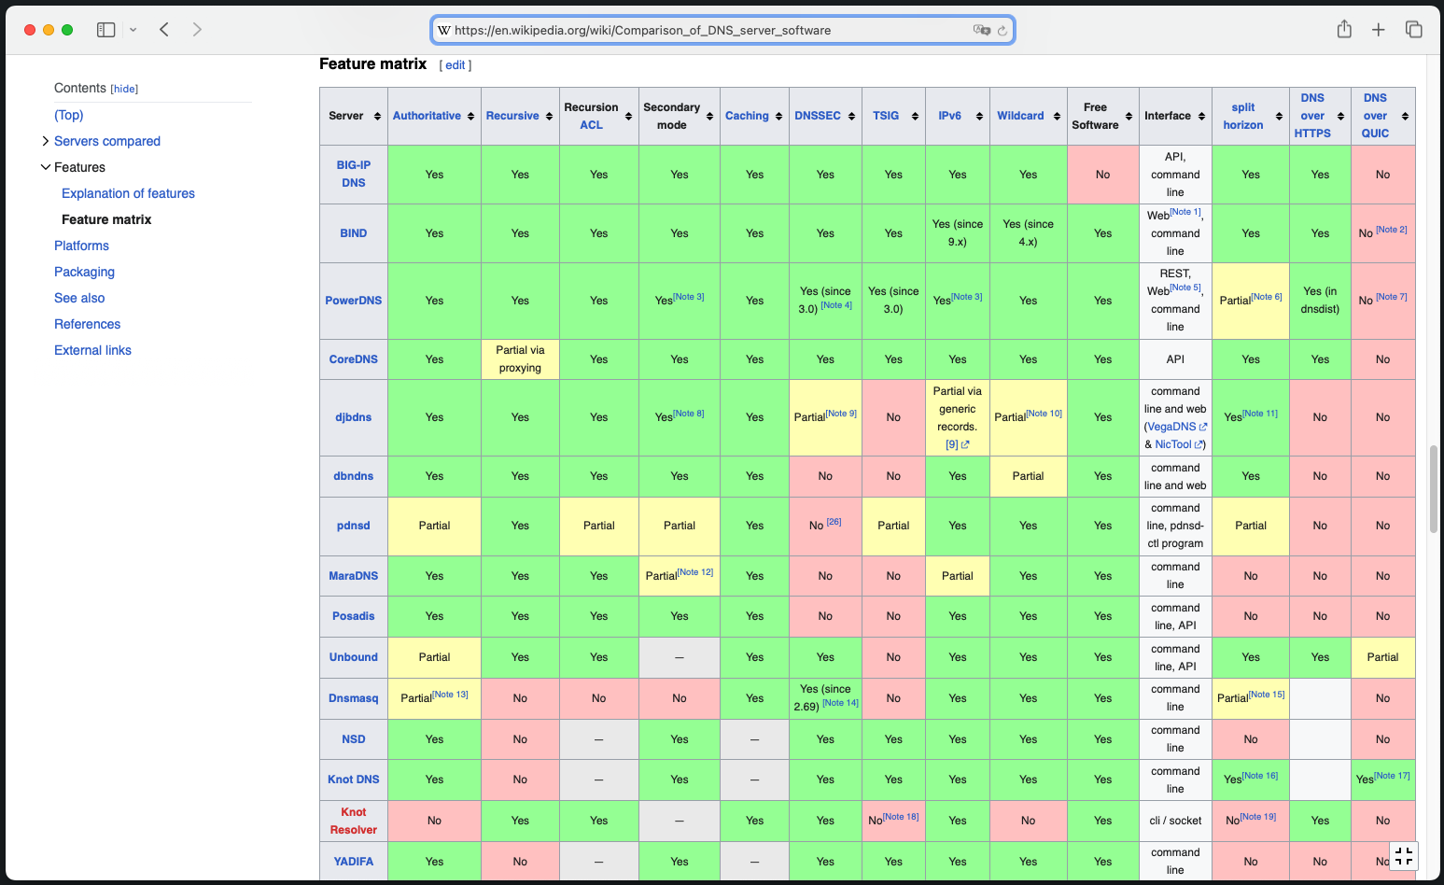
https://en.wikipedia.org/wiki/Comparison_of_DNS_server_software

Slide 11
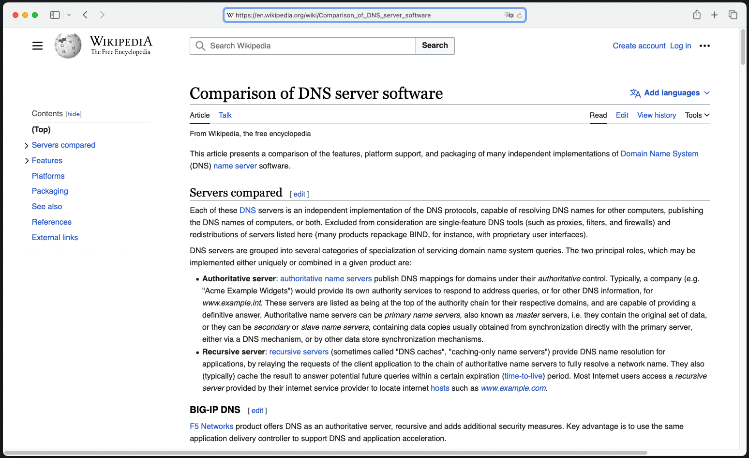
https://en.wikipedia.org/wiki/Comparison_of_DNS_server_software

Slide 12
https://en.wikipedia.org/wiki/Comparison_of_DNS_server_software

Slide 13
https://en.wikipedia.org/wiki/Comparison_of_DNS_server_software

Slide 14
https://en.wikipedia.org/wiki/Comparison_of_DNS_server_software

Slide 15
DNS RESOLVERS – EXAMPLES
Public DNS resolver (Google, Cloudflare, Quad9, OpenDNS ..)
DNS server running in your network e.g., your home network router
DNS server of your ISP, your employer, school, coffee shop ..
DNS resolver running on your system (systemd-resolved ..)
Any custom-built DNS resolver
OUR FOCUS

Slide 16
DNS RESOLVERS ARE IMPORTANT
DNS resolvers are critical infrastructure
Any downtime or a compromise has disastrous effect on many users
Threats:
DoS / DDoS, DNS flooding, DNS hijack, DNS cache poisoning, amplification, reflection, sloth domain attack, domain lock-up attacks, phantom domain attacks, NXDOMAIN attacks ..

Slide 17
HOW DO YOU PENTEST A DNS RESOLVER?

Slide 18



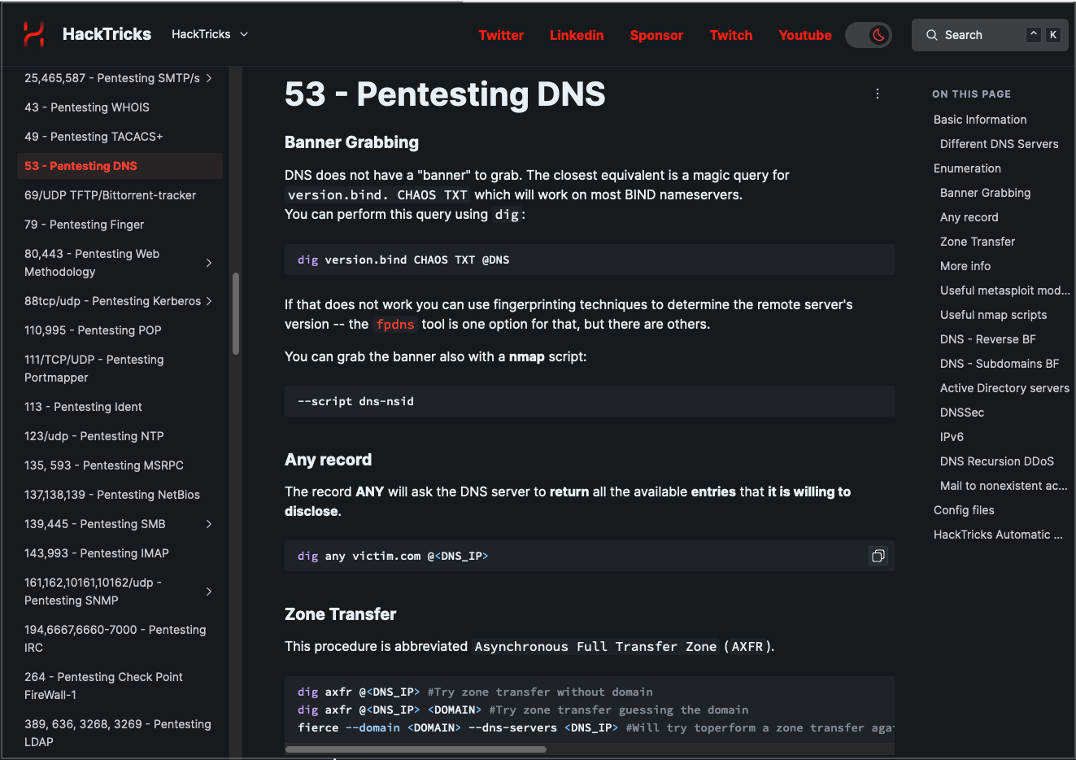
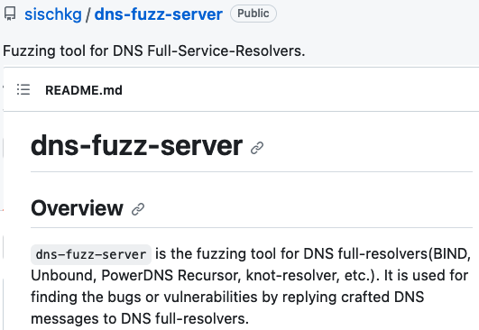
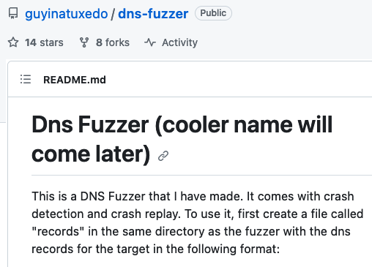
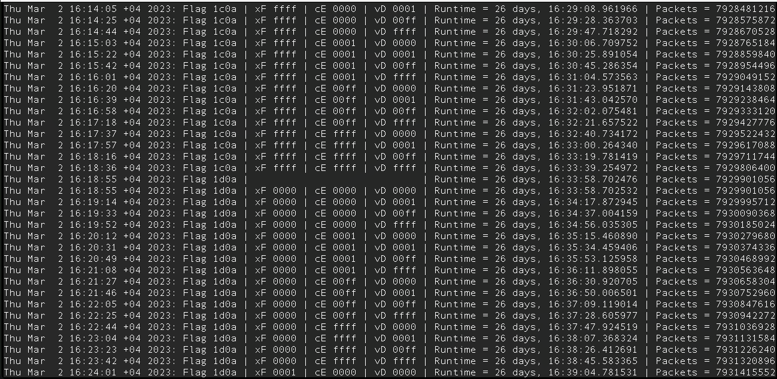


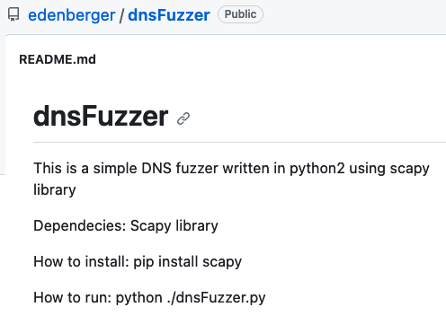

PENTESTING A DNS RESOLVER

Slide 19

PENTESTING A DNS RESOLVER
DNS resolver
Client

Slide 20

PENTESTING A DNS RESOLVER
DNS resolver
Is this enough?
No!
Client-to-Server
SME

Slide 21
PENTESTING A DNS RESOLVER
DNS resolver
DNS test server
Server-to-Server
Is this enough?
No!
We need to test it also from the server-side!
We need a special setup!
We need a special DNS server for pentesting!
Client-to-Server
SME

Slide 22

DNS TEST SERVER
HELLO DNS TEST SERVERS
ARE YOU THERE?

Slide 23

DNS TEST SERVER
We want to play with DNS!
Lack of existing projects for server-side attacks
Lack of coverage in the infosec community
WHERE IS EVERYONE?

Slide 24
HELLO

Slide 25
– INTRODUCTION
A specialized authoritative DNS server developed by OryxLabs specifically designed for penetration testing and vulnerability research
Gives the operator full control over the DNS protocol layer
PolarDNS supports both UDP and TCP modes of operation
It can generate custom DNS responses, including non-compliant, abnormal and even heavily malformed DNS responses

Slide 26

– INTRODUCTION
DNS PROTOCOL PARSERS
PolarDNS can be used for testing of:
DNS resolvers (DNS caches)
DNS clients
DNS libraries
DNS parsers and dissectors
Any software displaying, processing or handling DNS information
DNS PROTOCOL PARSERS EVERYWHERE

Slide 27
TESTING DNS RESOLVERS WITH

Slide 28
DEPLOYING TO TEST RESOLVERS
attacker.com
NS1
NS2
Purchase a domain
Get 2 VPS instances with public IPs (static)
Install PolarDNS server on both instances
In the domain registrar, delegate the domain to your nameservers

Slide 29
DEPLOYING TO TEST RESOLVERS
DEPLOYING
What is the IP of www.attacker.com ?
attacker.com
2.
DNS resolver
NS1
B A D
3.
?
NS2
What is the IP of www.attacker.com ?
1.
4.
Purchase a domain
Get 2 VPS instances with public IPs (static)
Install PolarDNS server on both instances
In the domain registrar, delegate the domain to your nameservers
?
SME

Slide 30
TESTING DNS CLIENTS WITH

Slide 31
DEPLOYING TO TEST DNS CLIENTS
DEPLOYING
attacker.com
NS1
NS2
What is the IP of www.attacker.com ?
1.
2.
B A D
Client
?

Slide 32
– KEY CONCEPT
By asking the PolarDNS server to resolve something, you are essentially giving it instructions how it should respond to you
You, as a client, dictate the PolarDNS server what kind of response it should produce for you
Very useful and convenient for testing purposes

Slide 33
CAPABILITIES

Slide 34
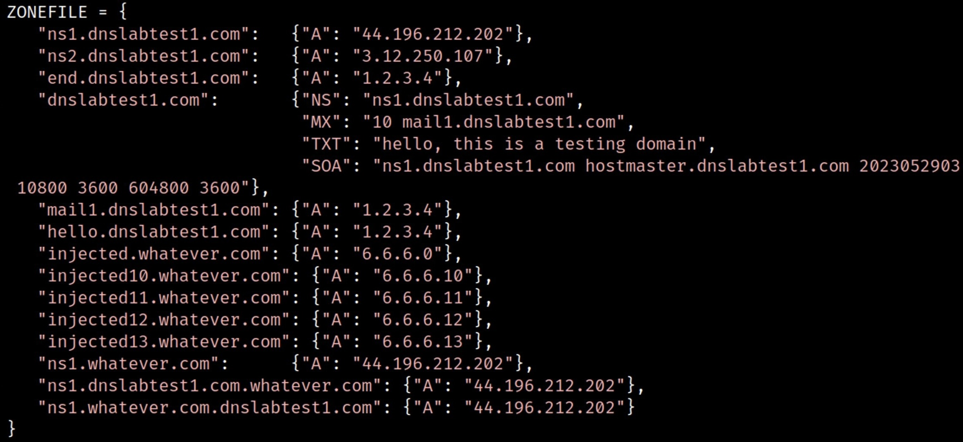
– CAPABILITIES
As an authoritative DNS server, it supports a standard static ZONE:

Slide 35
– CAPABILITIES
Generative capabilities containing approx. 60 features able to produce various DNS responses, many of which are parametrized
Additional 11 response modifiers which can further modify the response and which can be loosely combined together
can produce countless variants of different DNS responses

Slide 36
– SYNTAX 101
# dig <FEATURE>.[<PARAMETERS>].[<MODIFIERS>].attacker.com
# dig feature1.attacker.com
# dig feature2.500.1000.mod1.mod2.attacker.com

Slide 37
– FEATURE CATALOGUE
The tool comes with a catalogue, listing all the features and response modifiers, including:
Description
Format (syntax)
Examples
Remarks
Sample output

Slide 38
RUNNING
PolarDNS repository: https://github.com/OryxLabs/PolarDNS
Add your domain name and IP addresses to the polardns.yml configuration file
Transfer polardns.yml and polardns.py files to your VPS instances
Run PolarDNS:
(Requirement: Python 3.10 or newer)
# python polardns.py

Slide 39
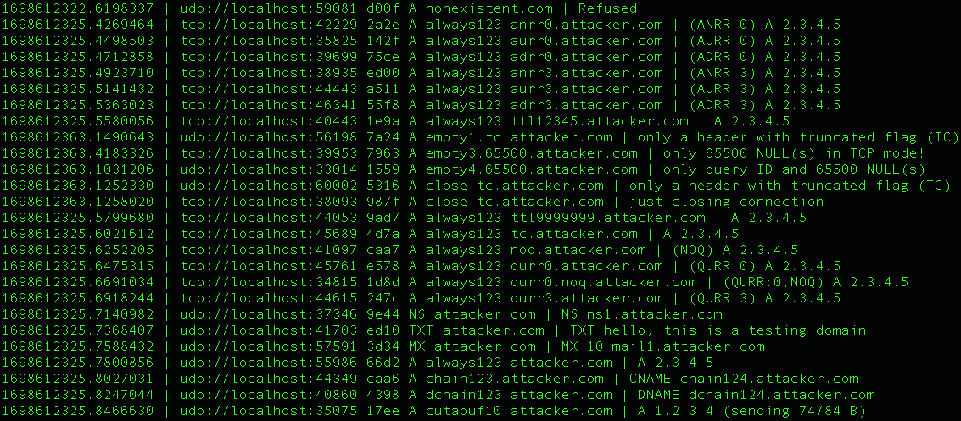
RUNNING
___Timestamp | Source IP + port _ ID _ Incoming query | __Our response _

Slide 40
EXAMPLES

Slide 41
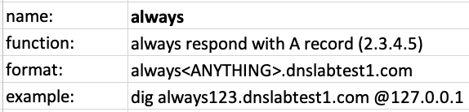
ALWAYS RESOLVE TO IP
always.dnslabtest1.com

Slide 42
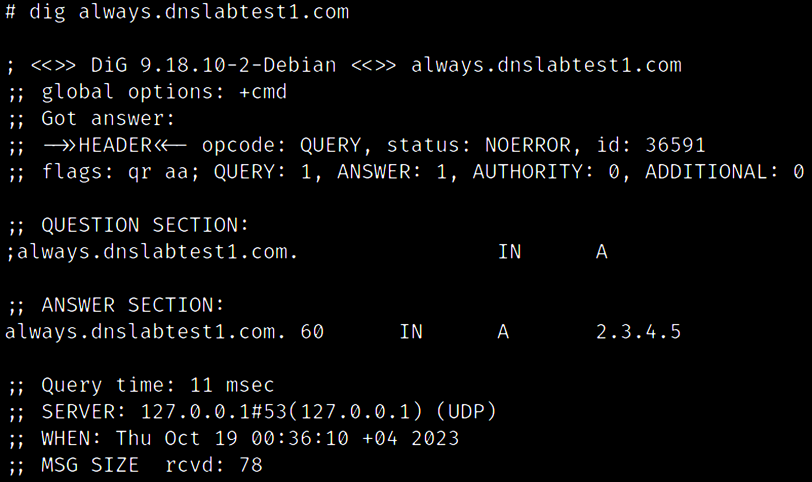
ALWAYS RESOLVE TO IP

Slide 43
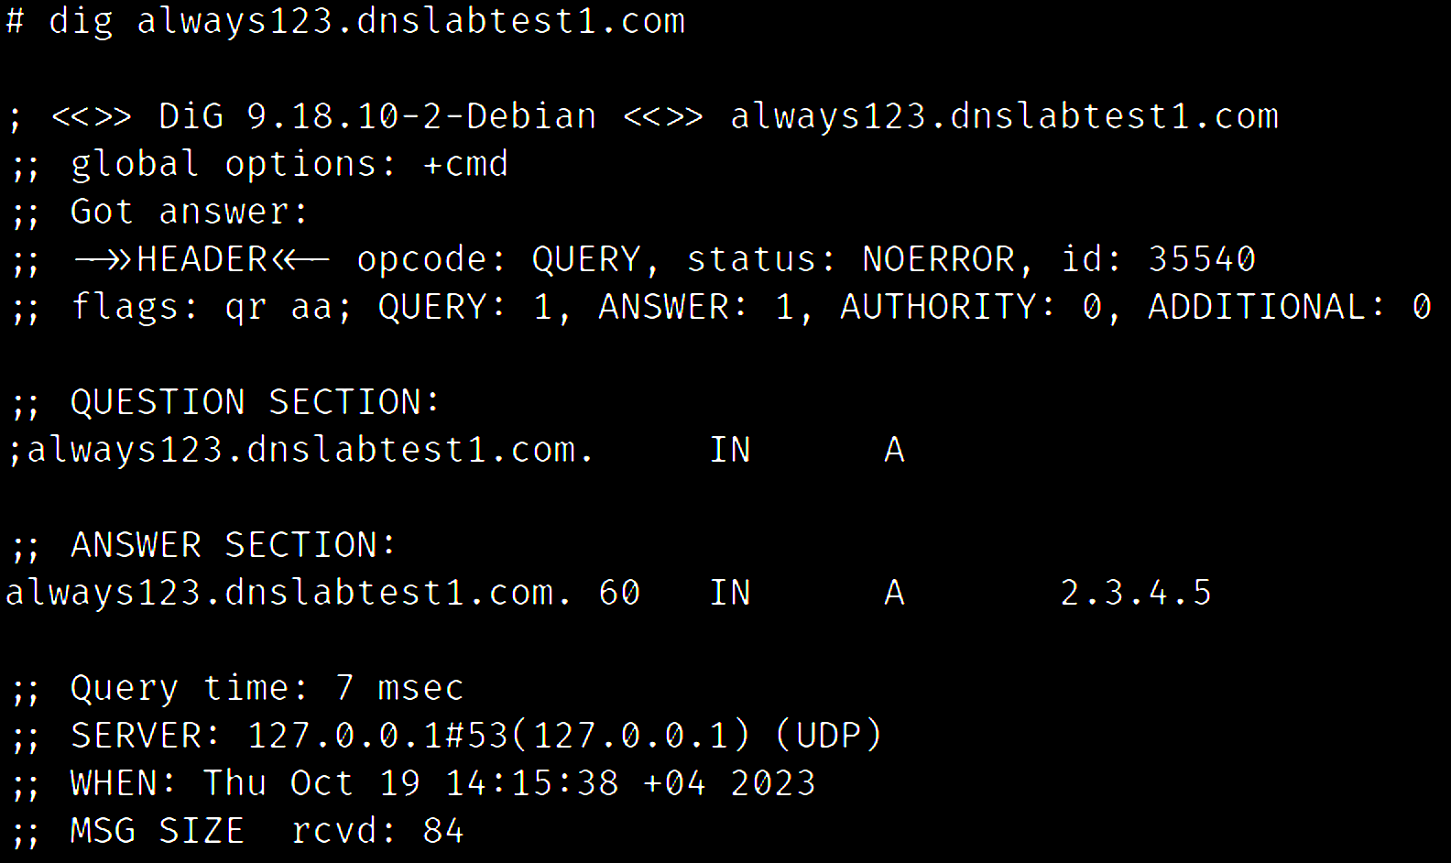
ALWAYS RESOLVE TO IP

Slide 44
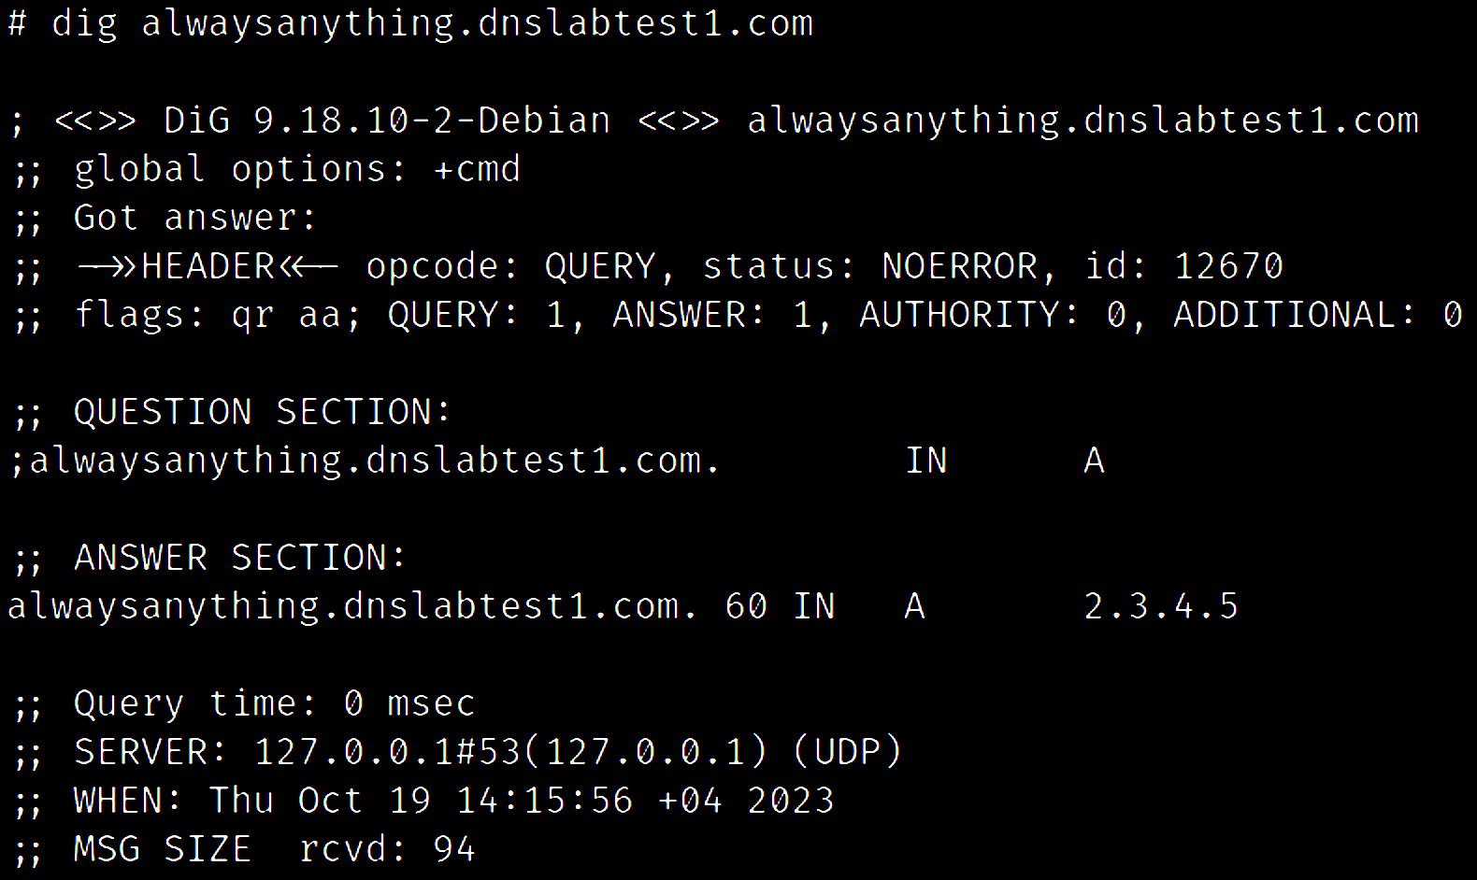
ALWAYS RESOLVE TO IP

Slide 45
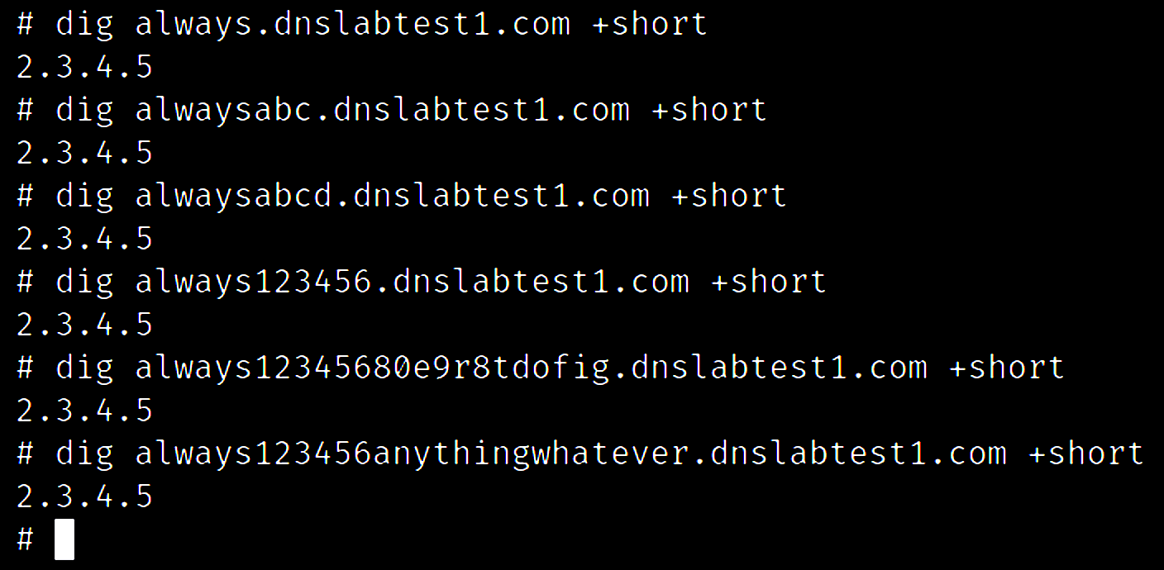
AVOID GETTING CACHED RESPONSES
Any random string after the feature name is ignored.
This ensures that the target DNS resolver always fetches a fresh response from our PolarDNS instances.

Slide 46
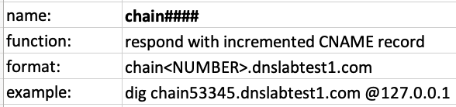
FORM ALIAS CHAINS
chain.dnslabtest1.com

Slide 47
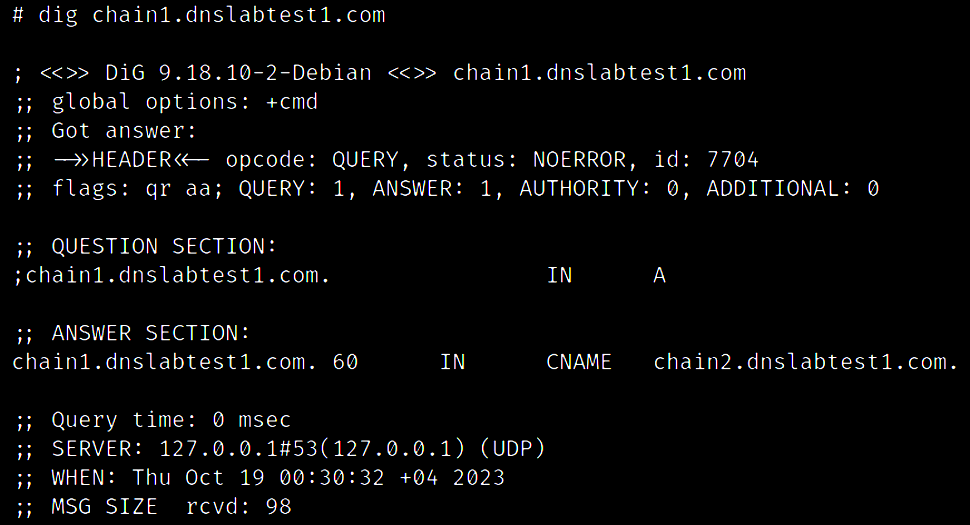
FORM ALIAS CHAINS

Slide 48

FORM ALIAS CHAINS

Slide 49
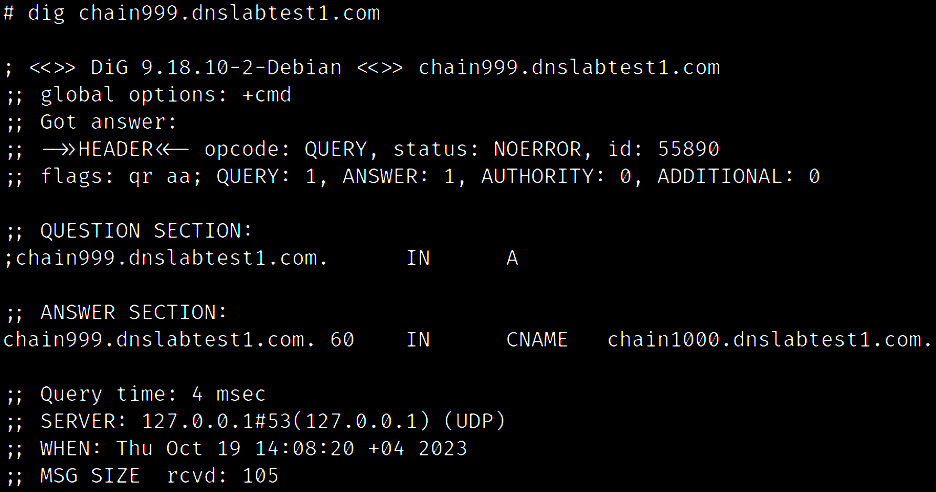
FORM ALIAS CHAINS

Slide 50
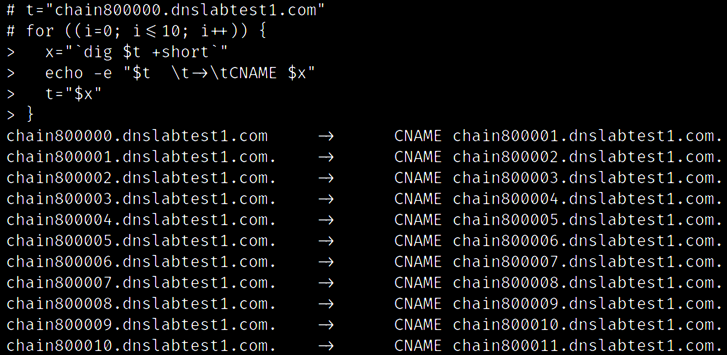
FORM ALIAS CHAINS

Slide 51
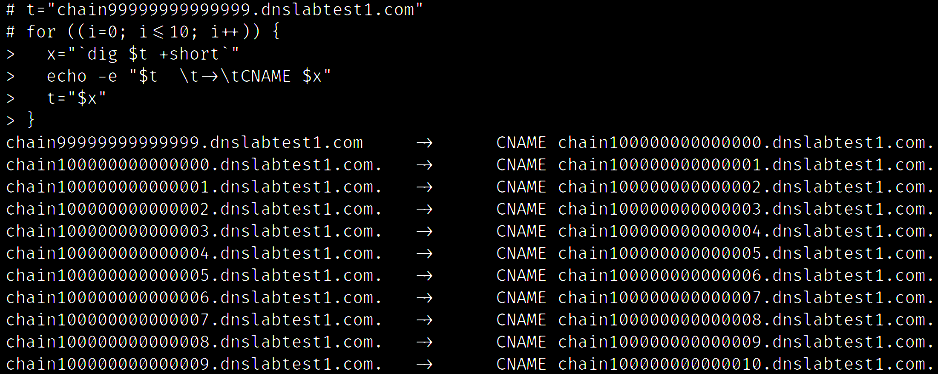

FORM ALIAS CHAINS
TO INFINITY
AND BEYOND

Slide 52
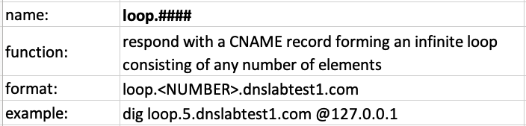
FORM ALIAS LOOPS
loop.dnslabtest1.com

Slide 53
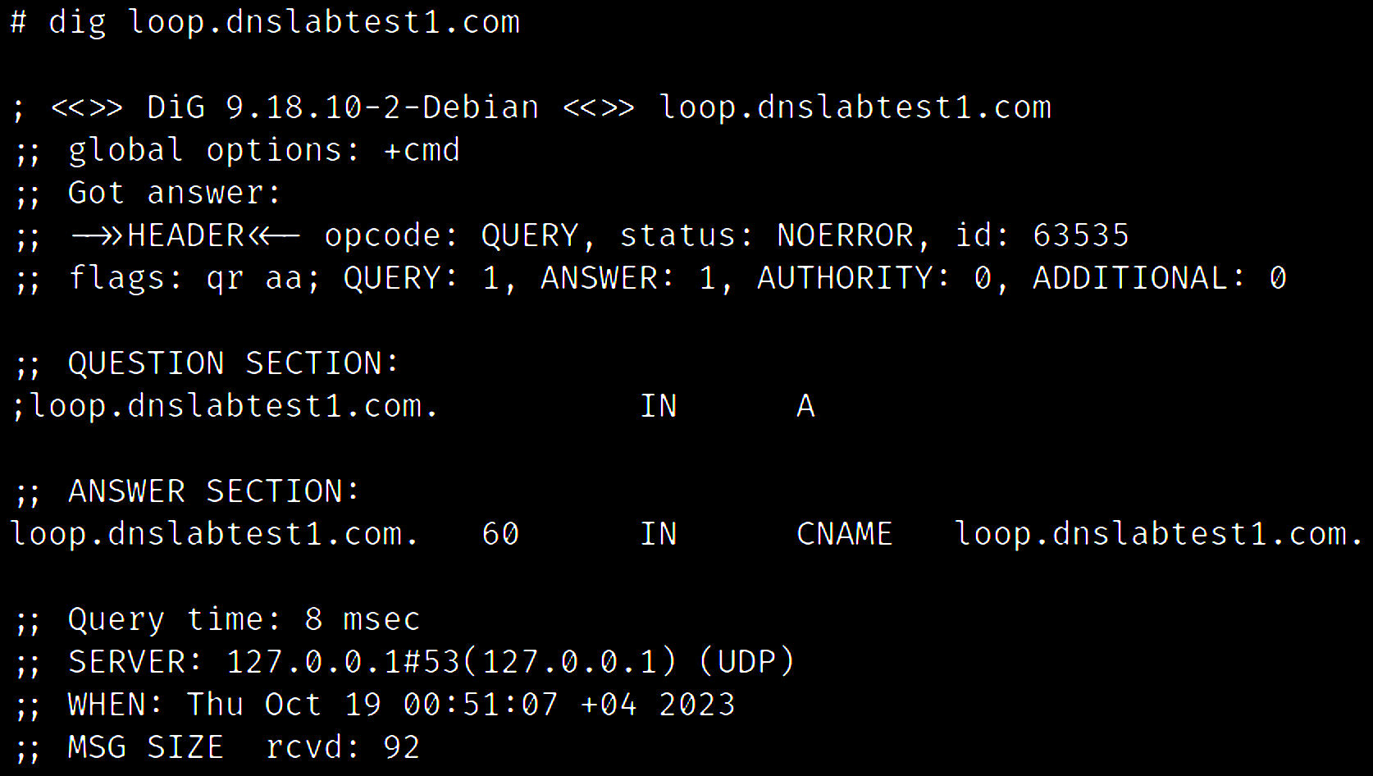
FORM ALIAS LOOPS

Slide 54
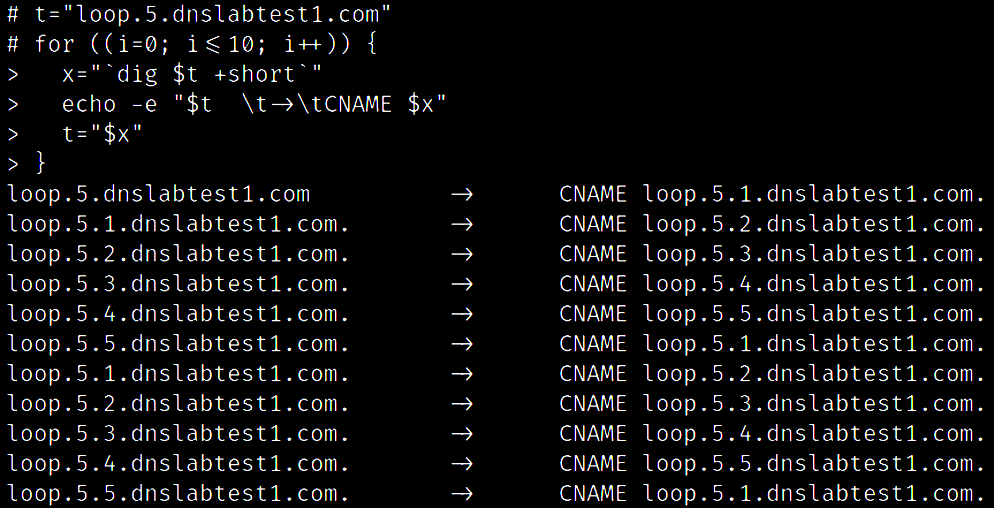
FORM ALIAS LOOPS

Slide 55
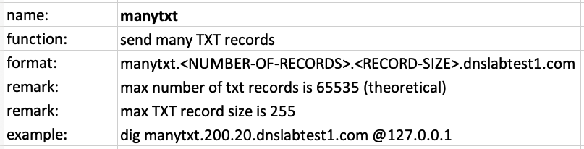
GENERATE RANDOM TXT RECORDS
manytxt.dnslabtest1.com

Slide 56
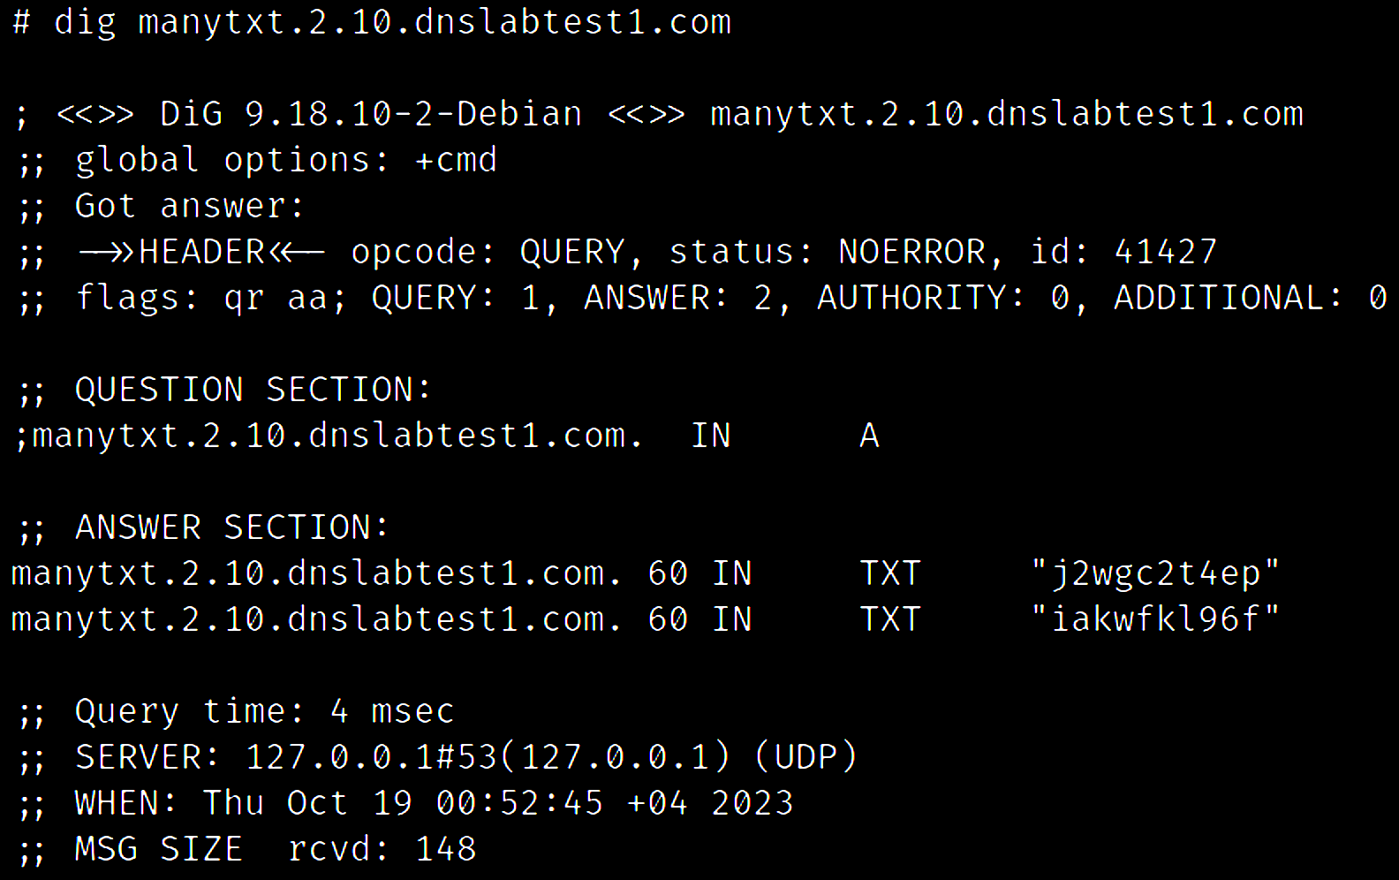
GENERATE RANDOM TXT RECORDS

Slide 57
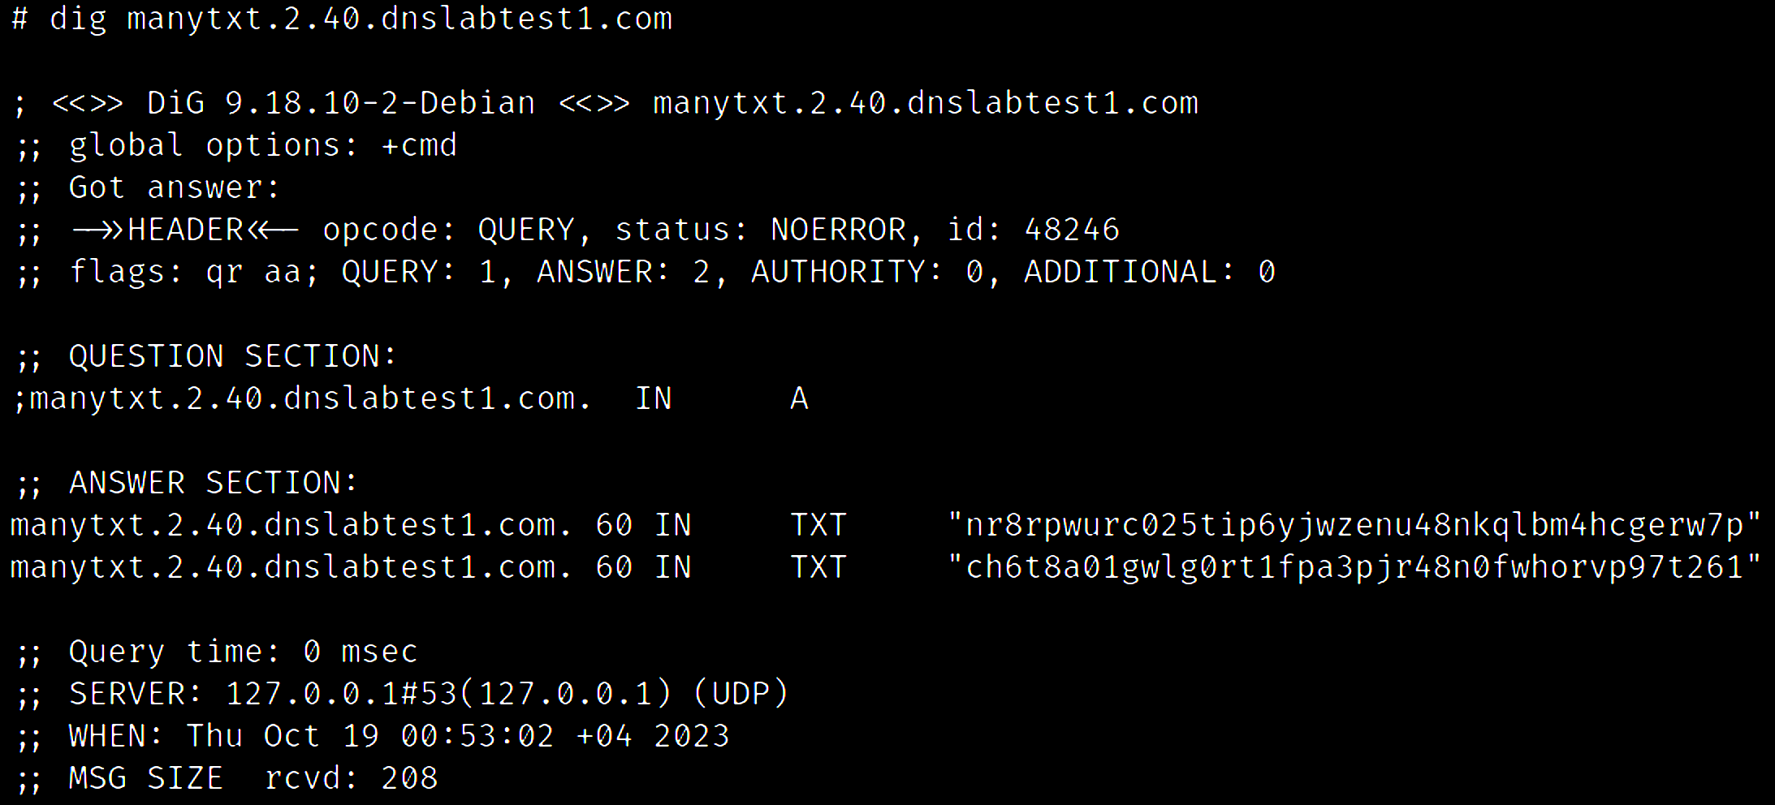
GENERATE RANDOM TXT RECORDS

Slide 58
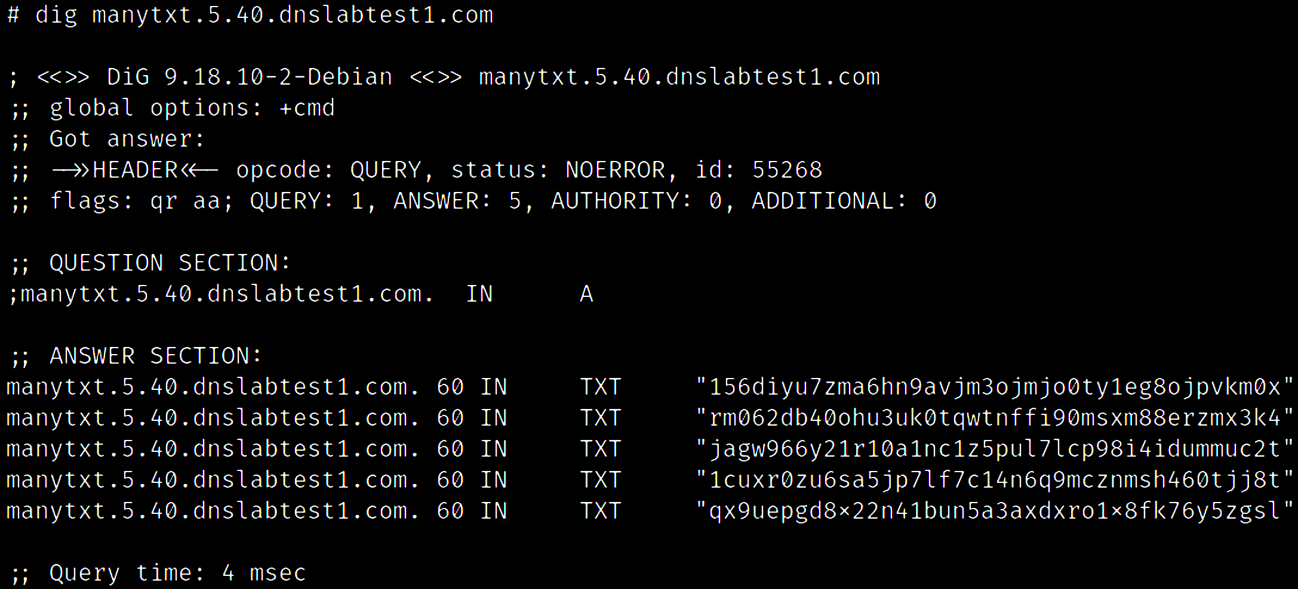
GENERATE RANDOM TXT RECORDS

Slide 59
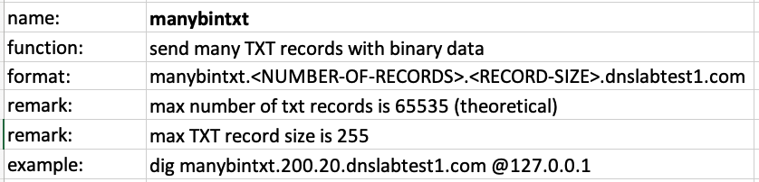
GENERATE RANDOM BINARY TXT RECORDS
manybintxt.dnslabtest1.com

Slide 60
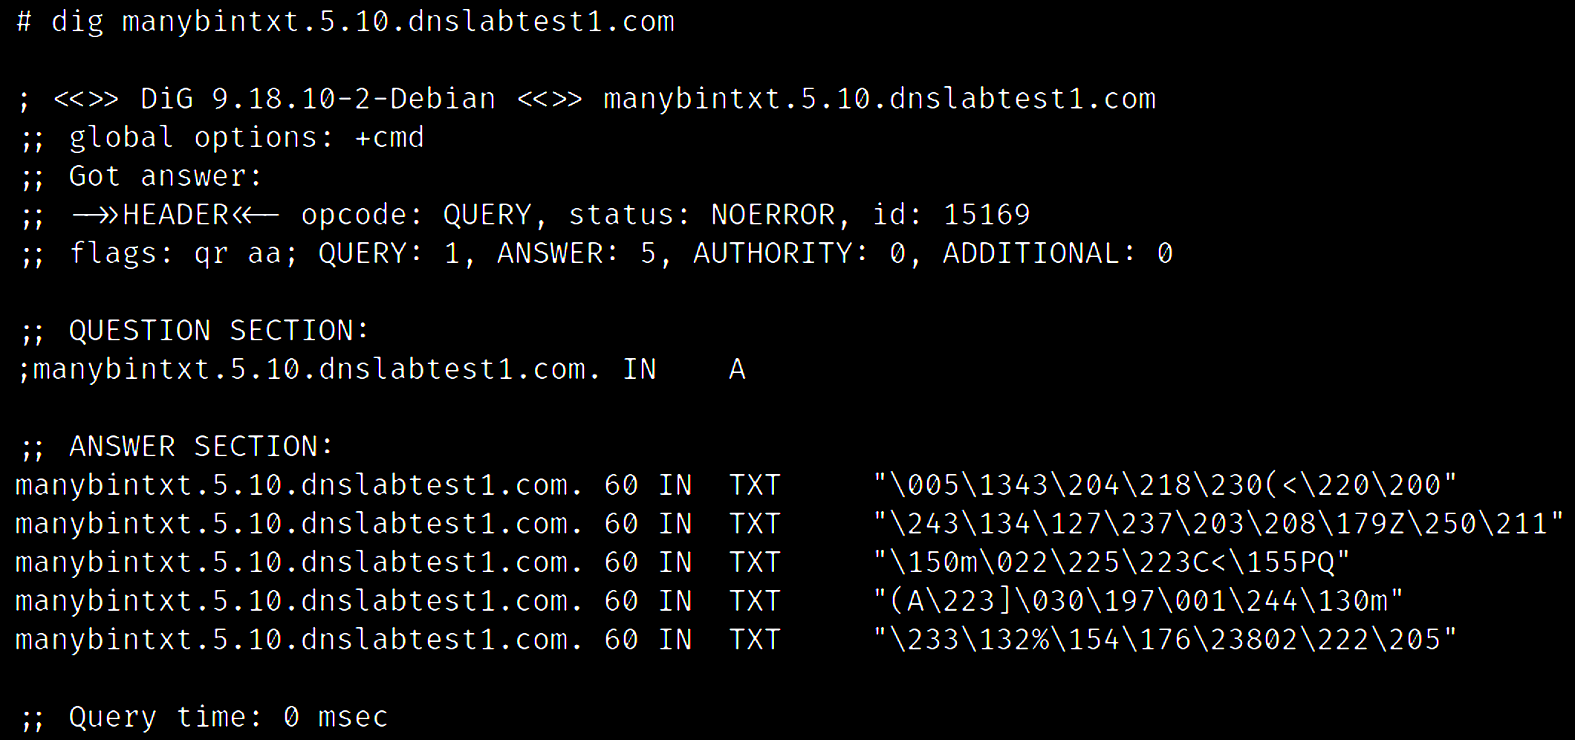
GENERATE RANDOM BINARY TXT RECORDS

Slide 61
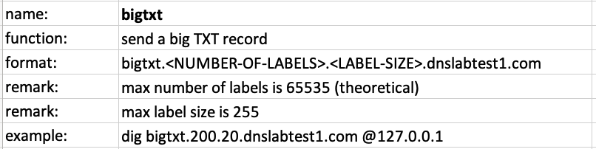
GENERATE LONG TXT RECORD
bigtxt.dnslabtest1.com

Slide 62
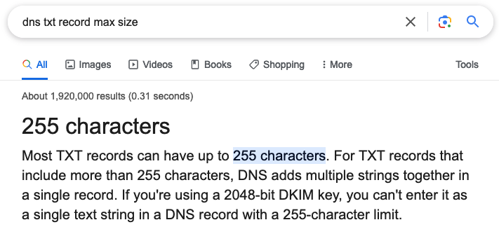
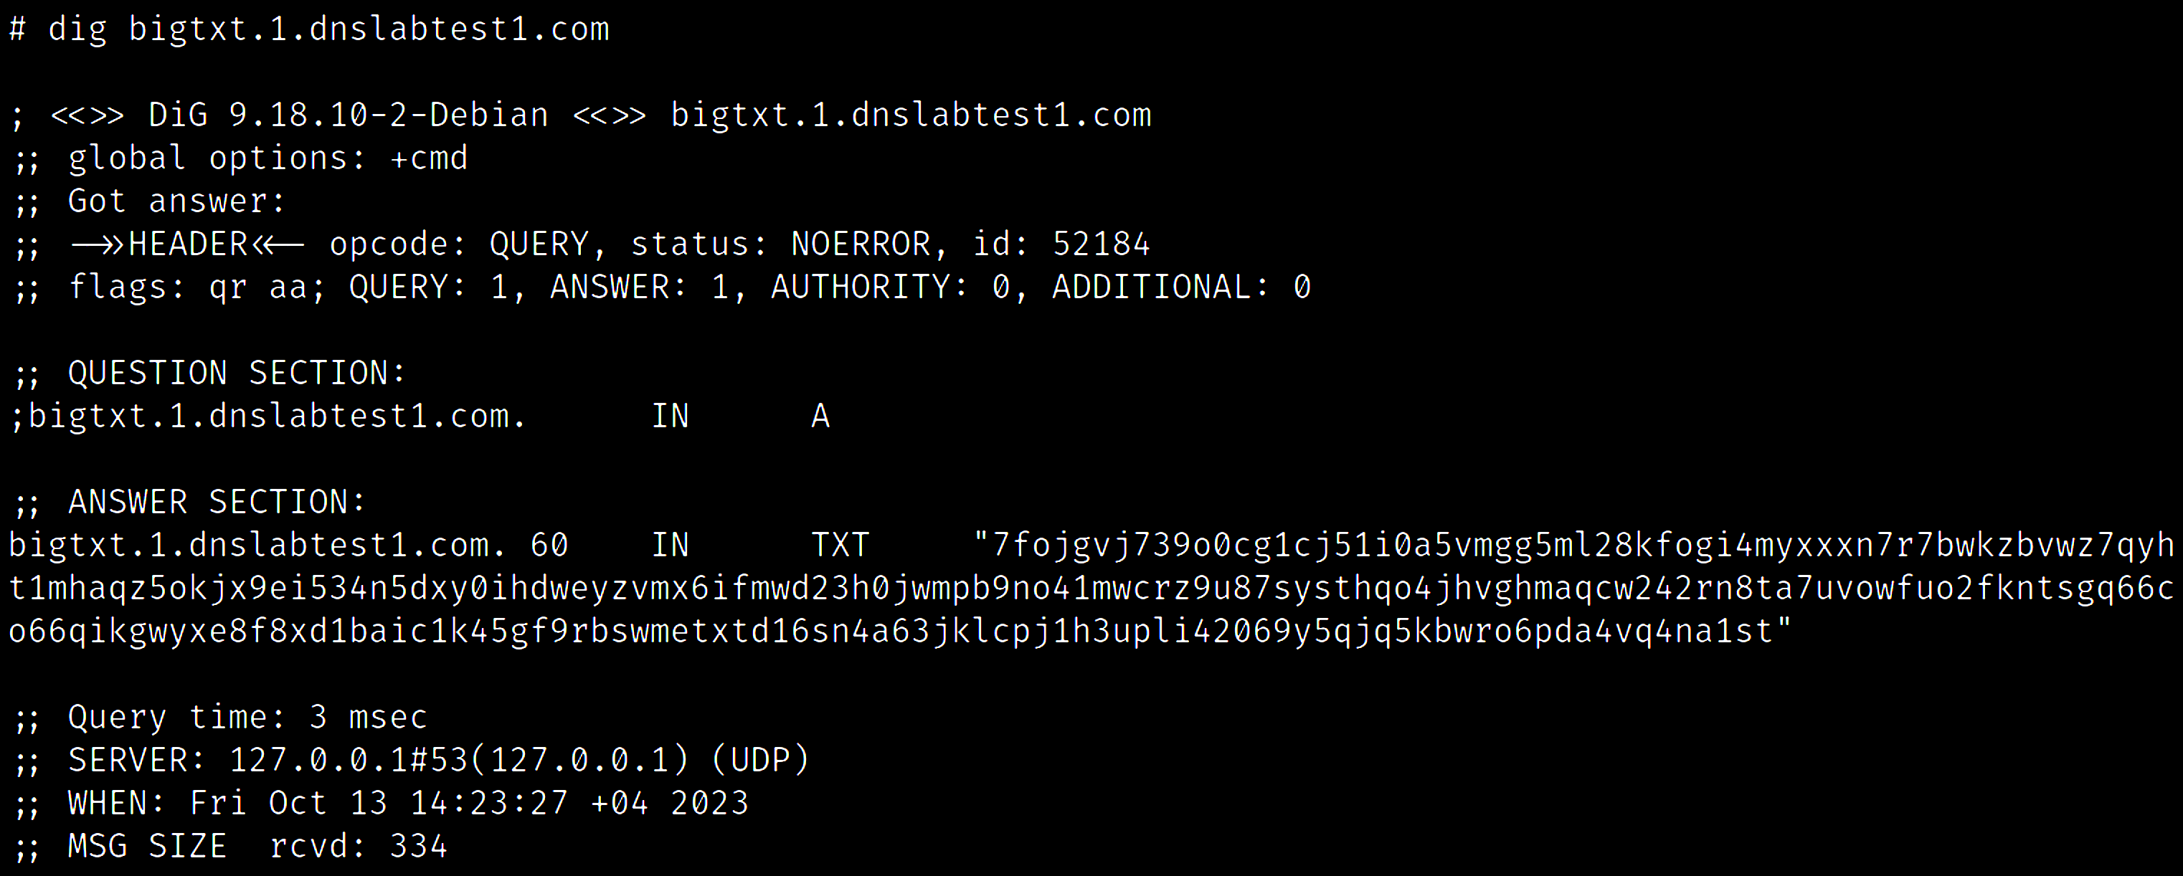
GENERATE LONG TXT RECORD
255 .

Slide 63
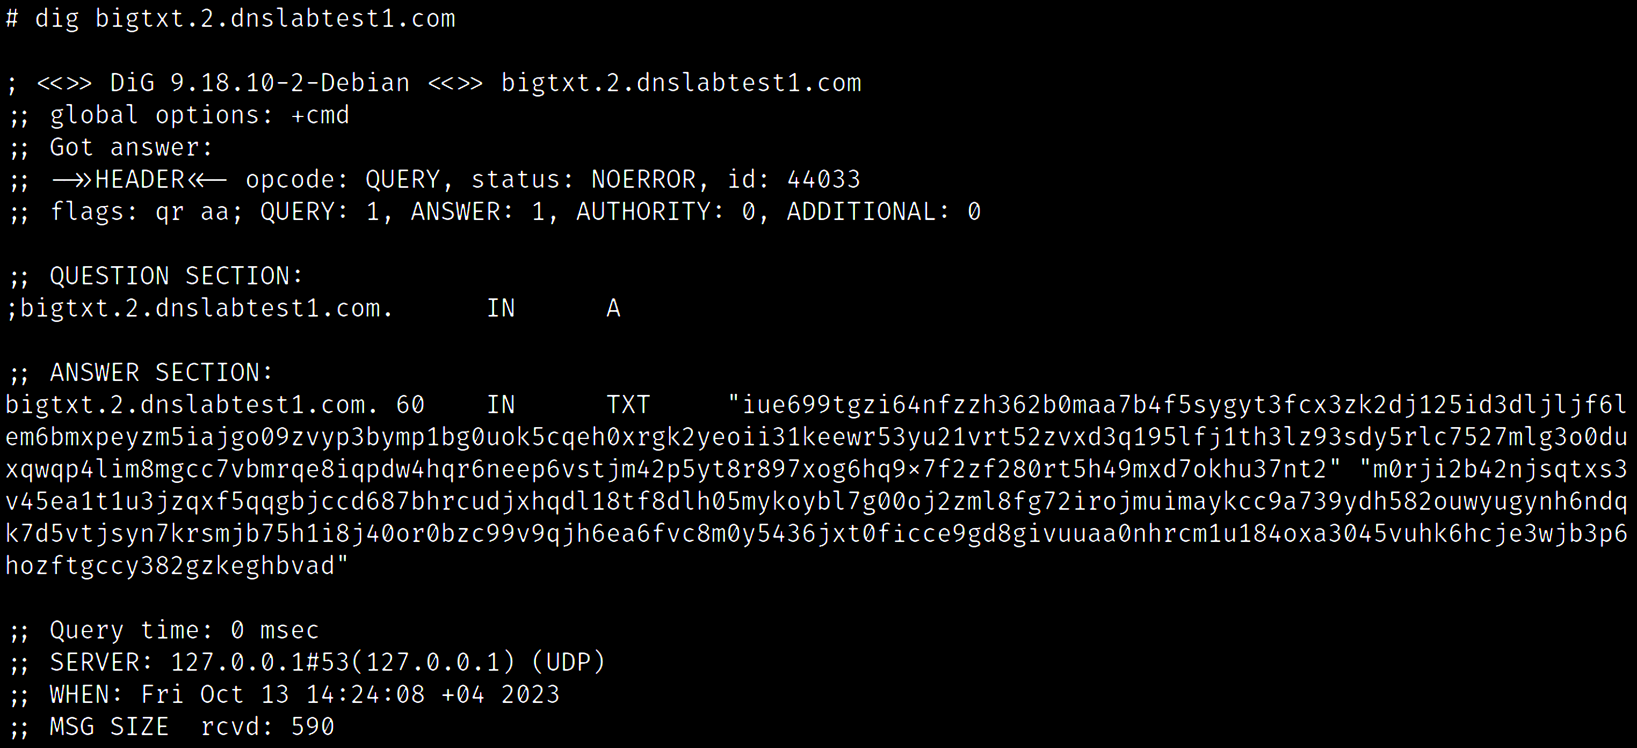
GENERATE LONG TXT RECORD
255 .
255 .

Slide 64
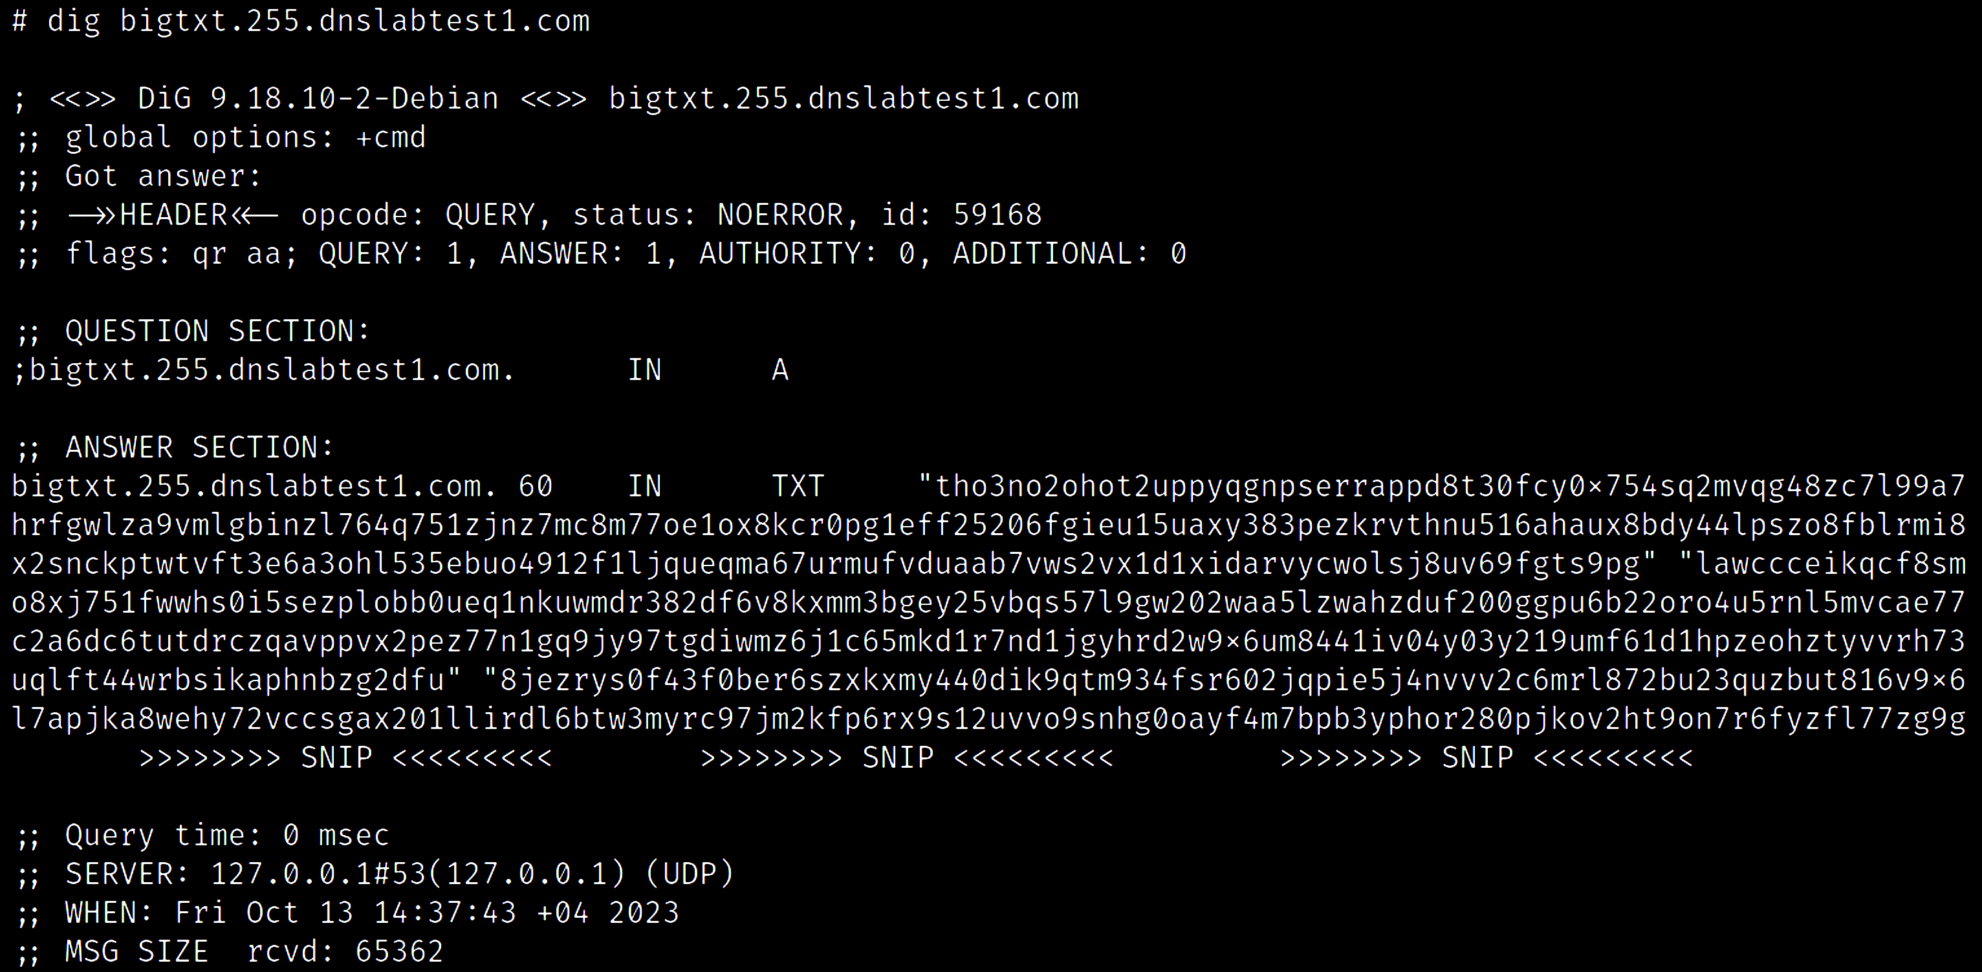
GENERATE LONG TXT RECORD
255 x 255 .

Slide 65
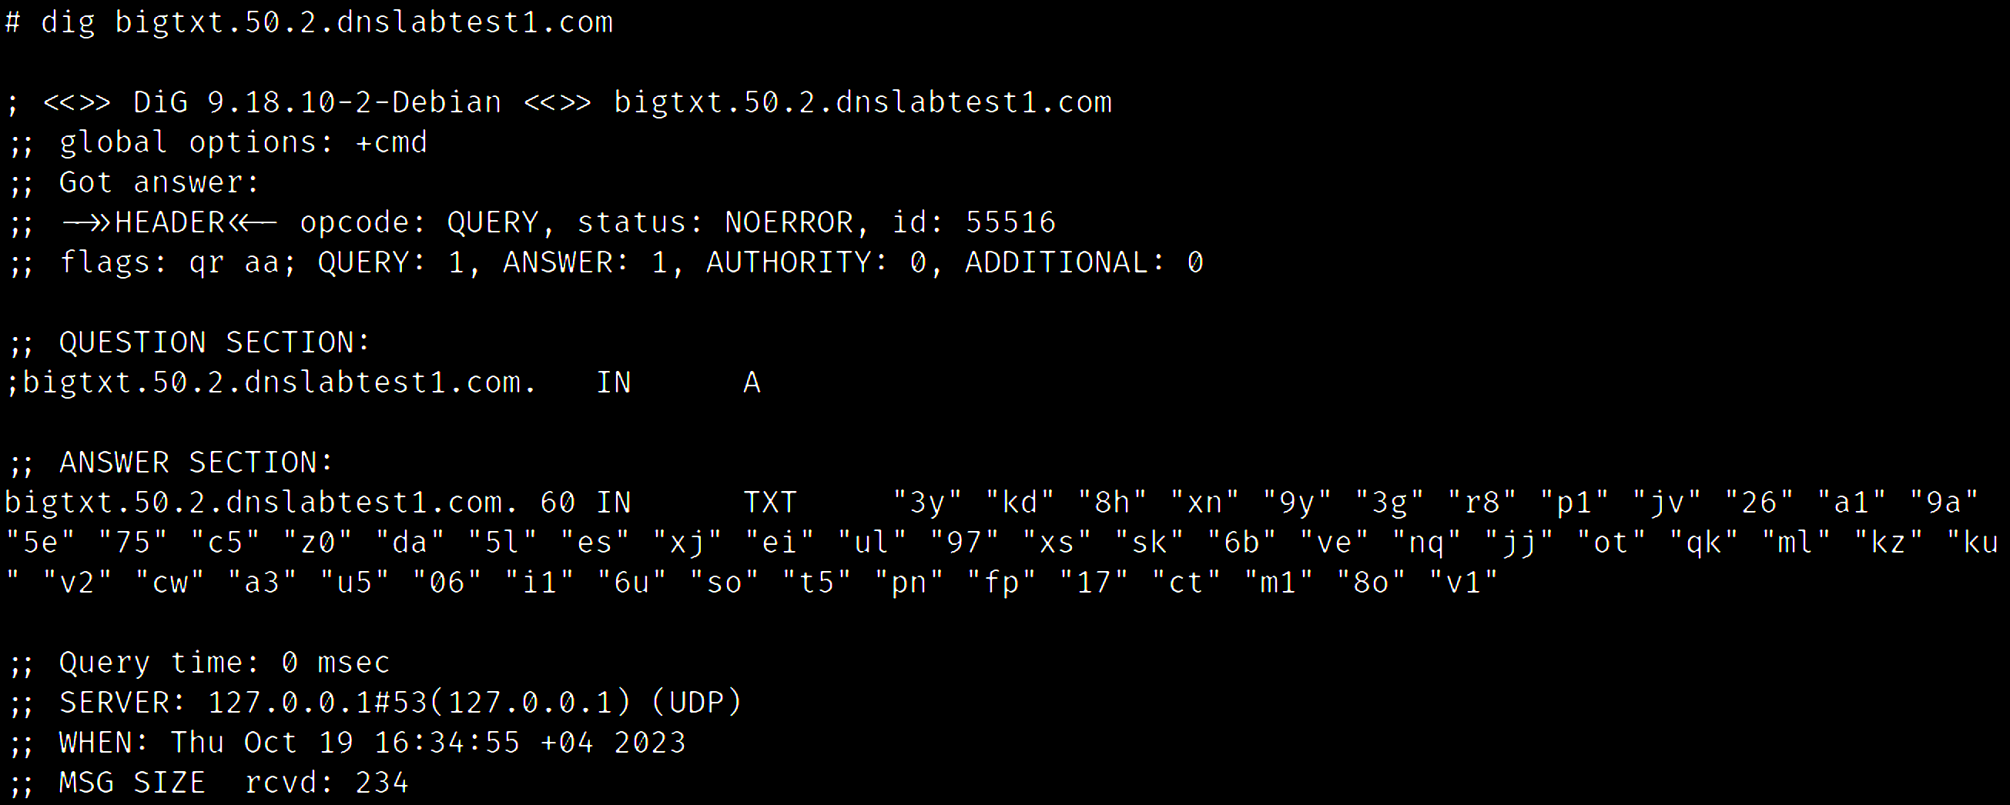
GENERATE LONG TXT RECORD
50 strings made of 2 random characters

Slide 66
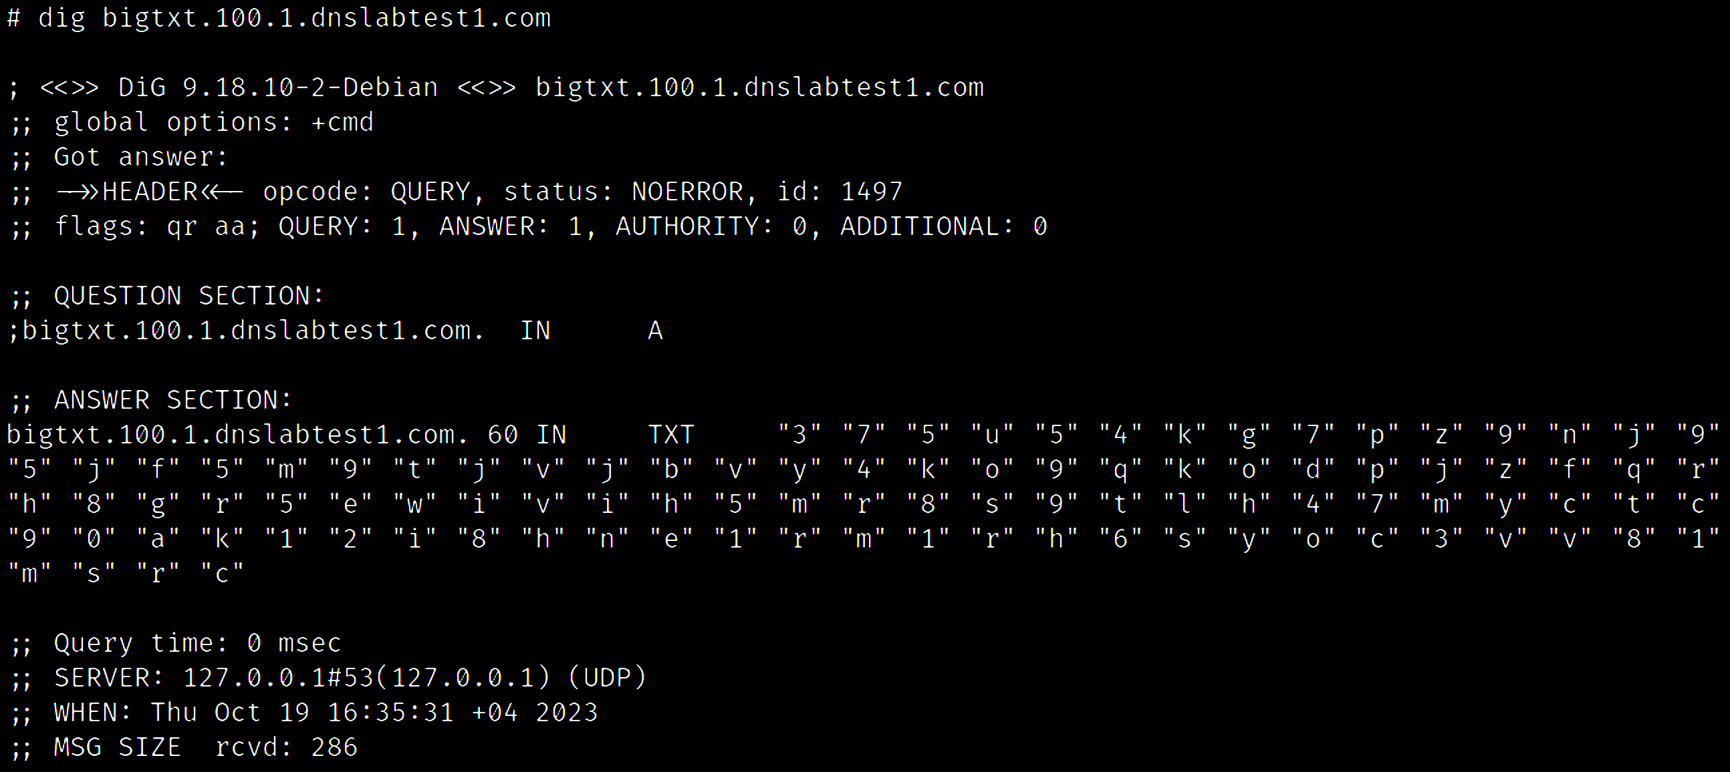
GENERATE LONG TXT RECORD
100 strings made of 1 random character

Slide 67

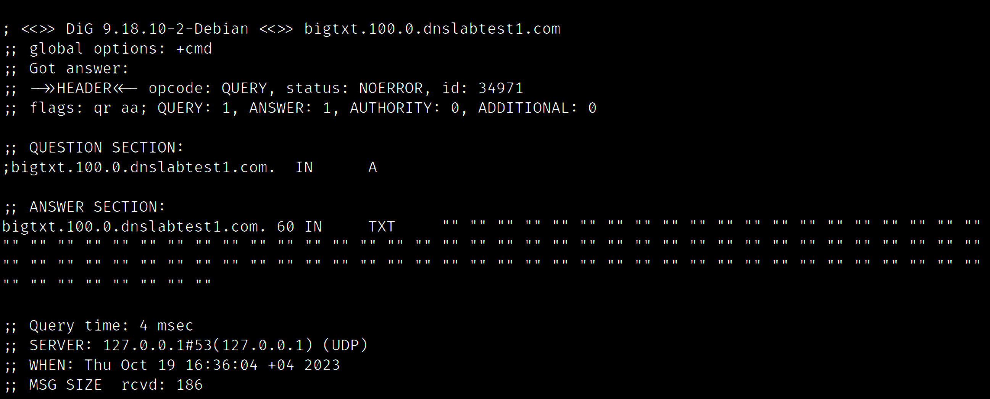
GENERATE LONG TXT RECORD
JUST SO YOU KNOW
100 empty strings

Slide 68
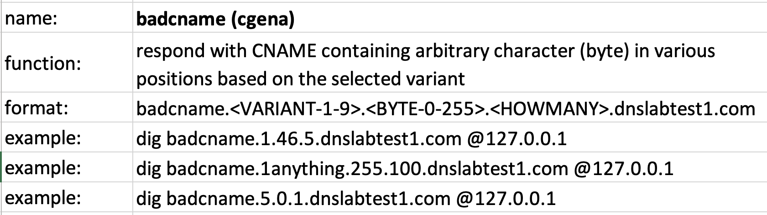
DOMAIN NAMES CONTAINING ILLEGAL CHARACTERS
badcname.dnslabtest1.com

Slide 69
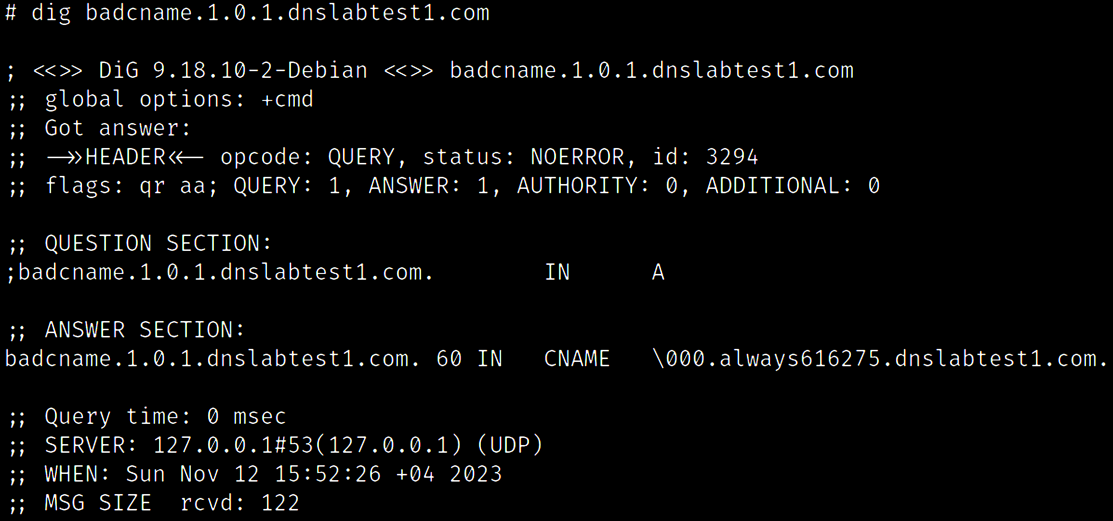
DOMAIN NAMES CONTAINING ILLEGAL CHARACTERS
position
byte
how many

Slide 70
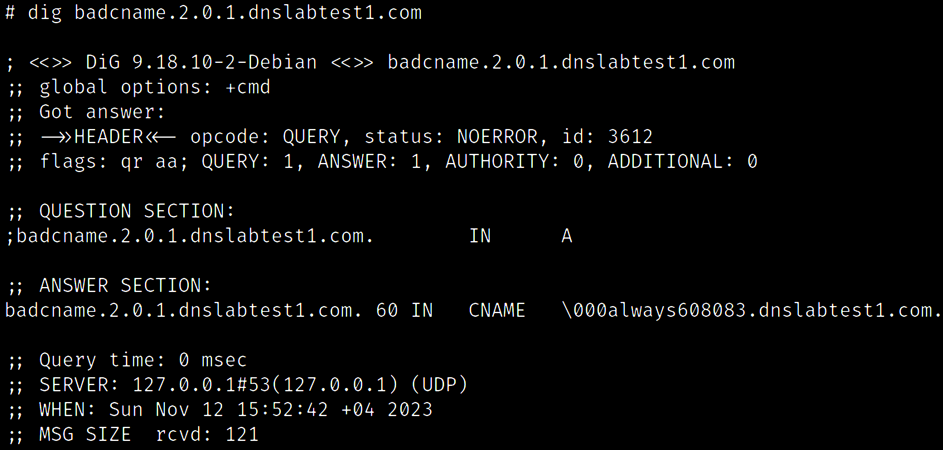
DOMAIN NAMES CONTAINING ILLEGAL CHARACTERS

Slide 71
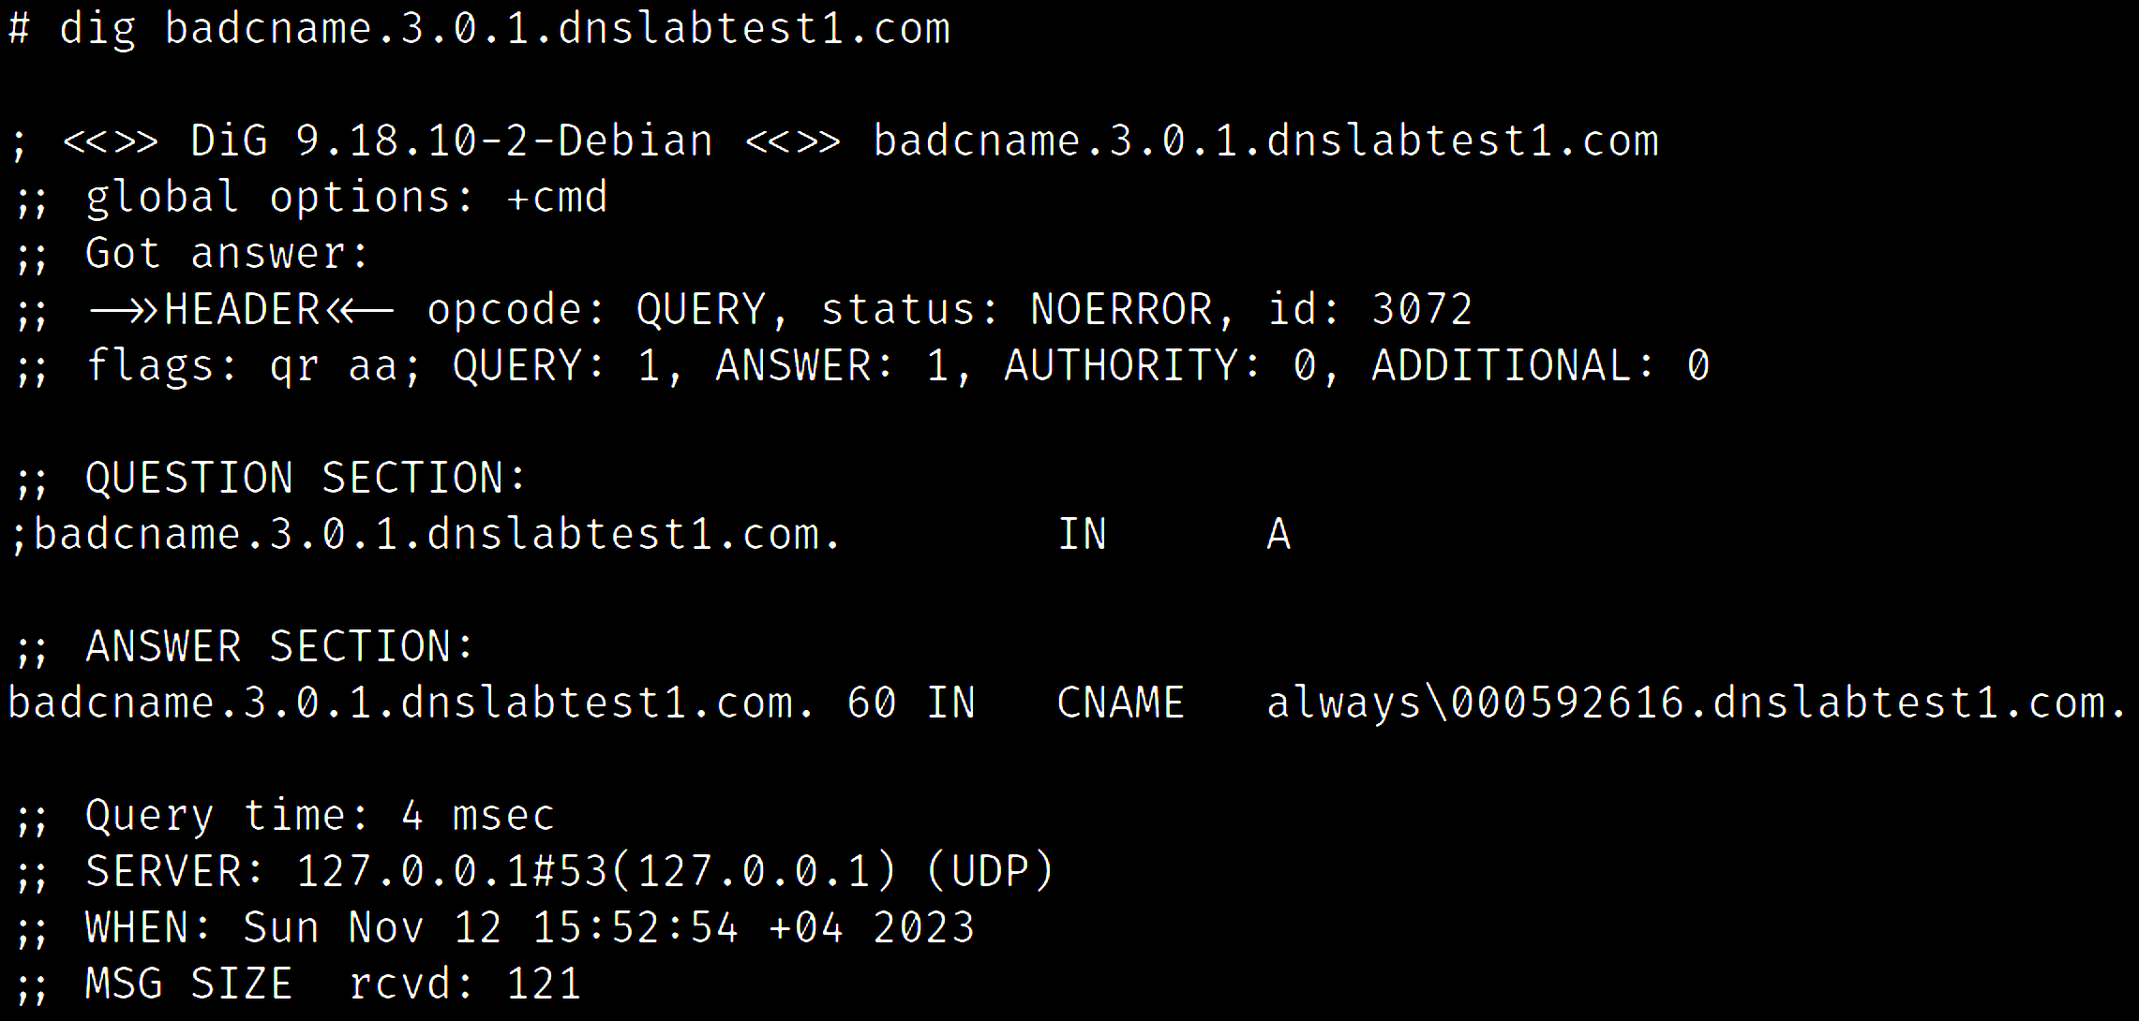
DOMAIN NAMES CONTAINING ILLEGAL CHARACTERS

Slide 72
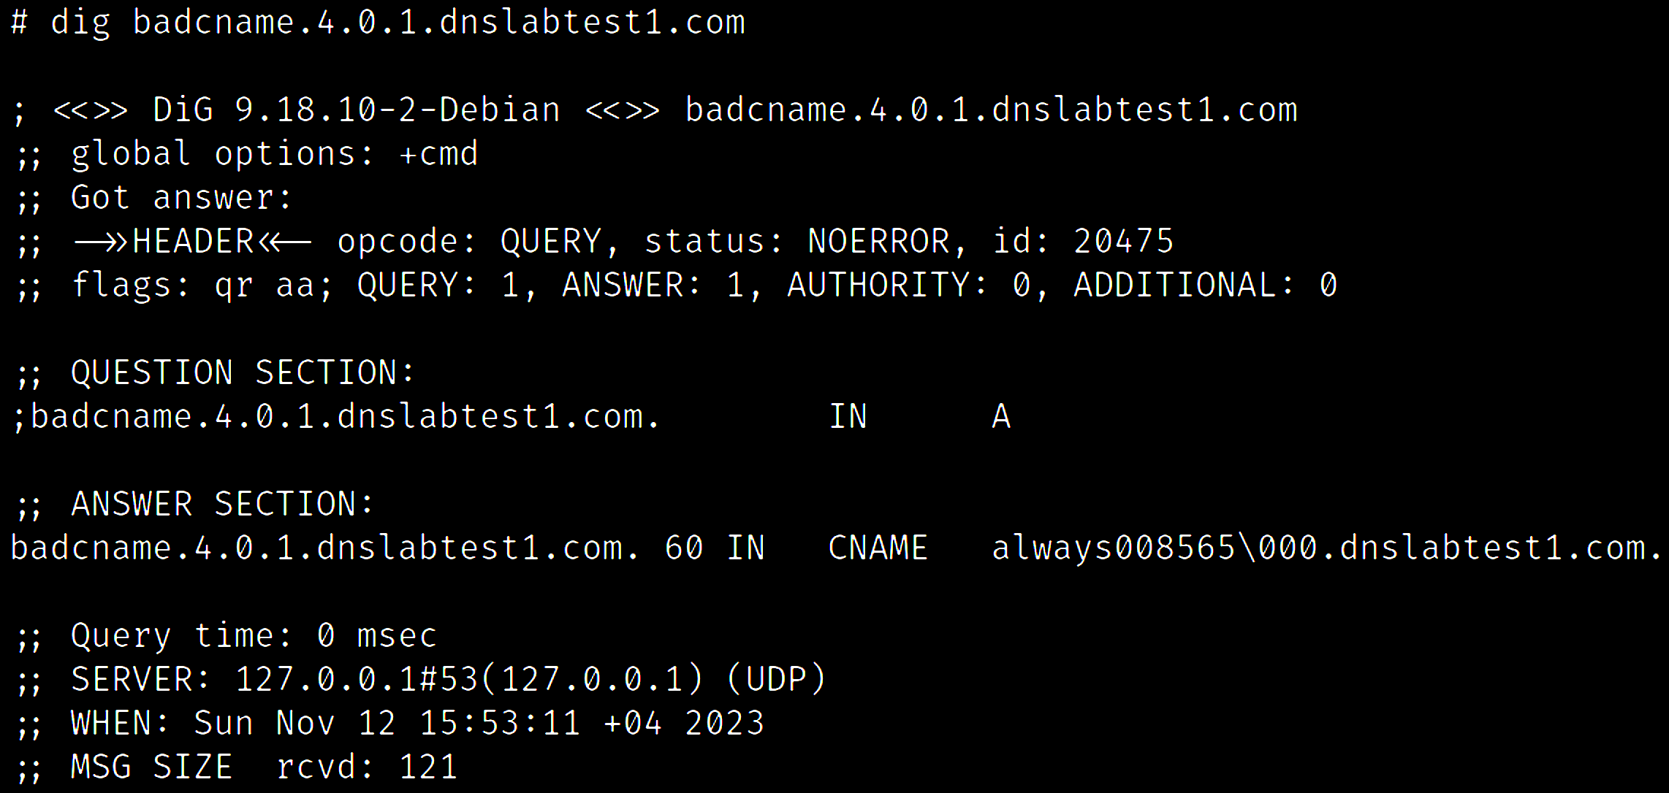
DOMAIN NAMES CONTAINING ILLEGAL CHARACTERS

Slide 73
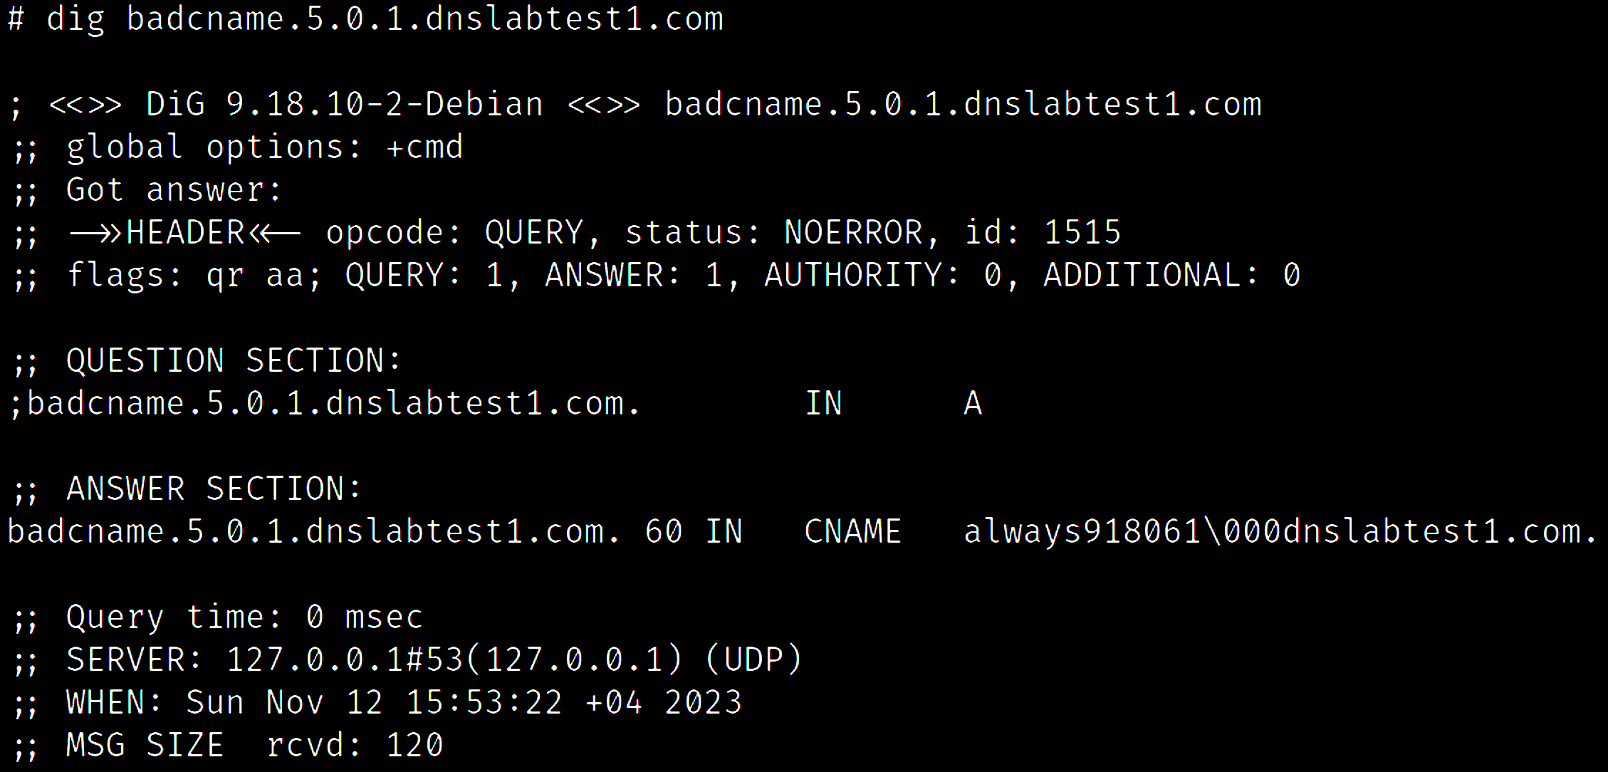
DOMAIN NAMES CONTAINING ILLEGAL CHARACTERS

Slide 74
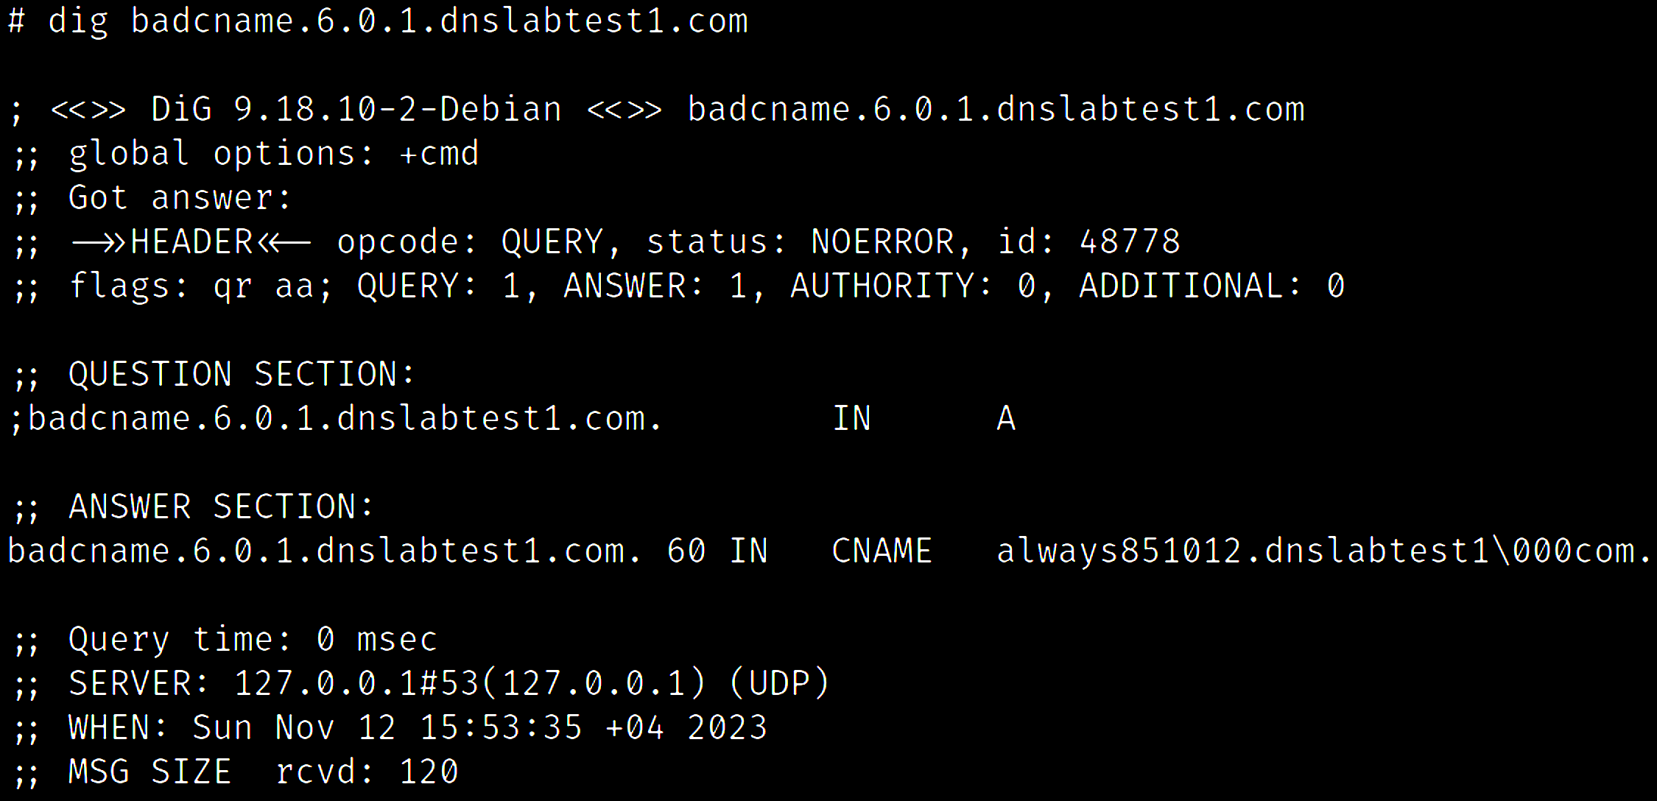
DOMAIN NAMES CONTAINING ILLEGAL CHARACTERS

Slide 75
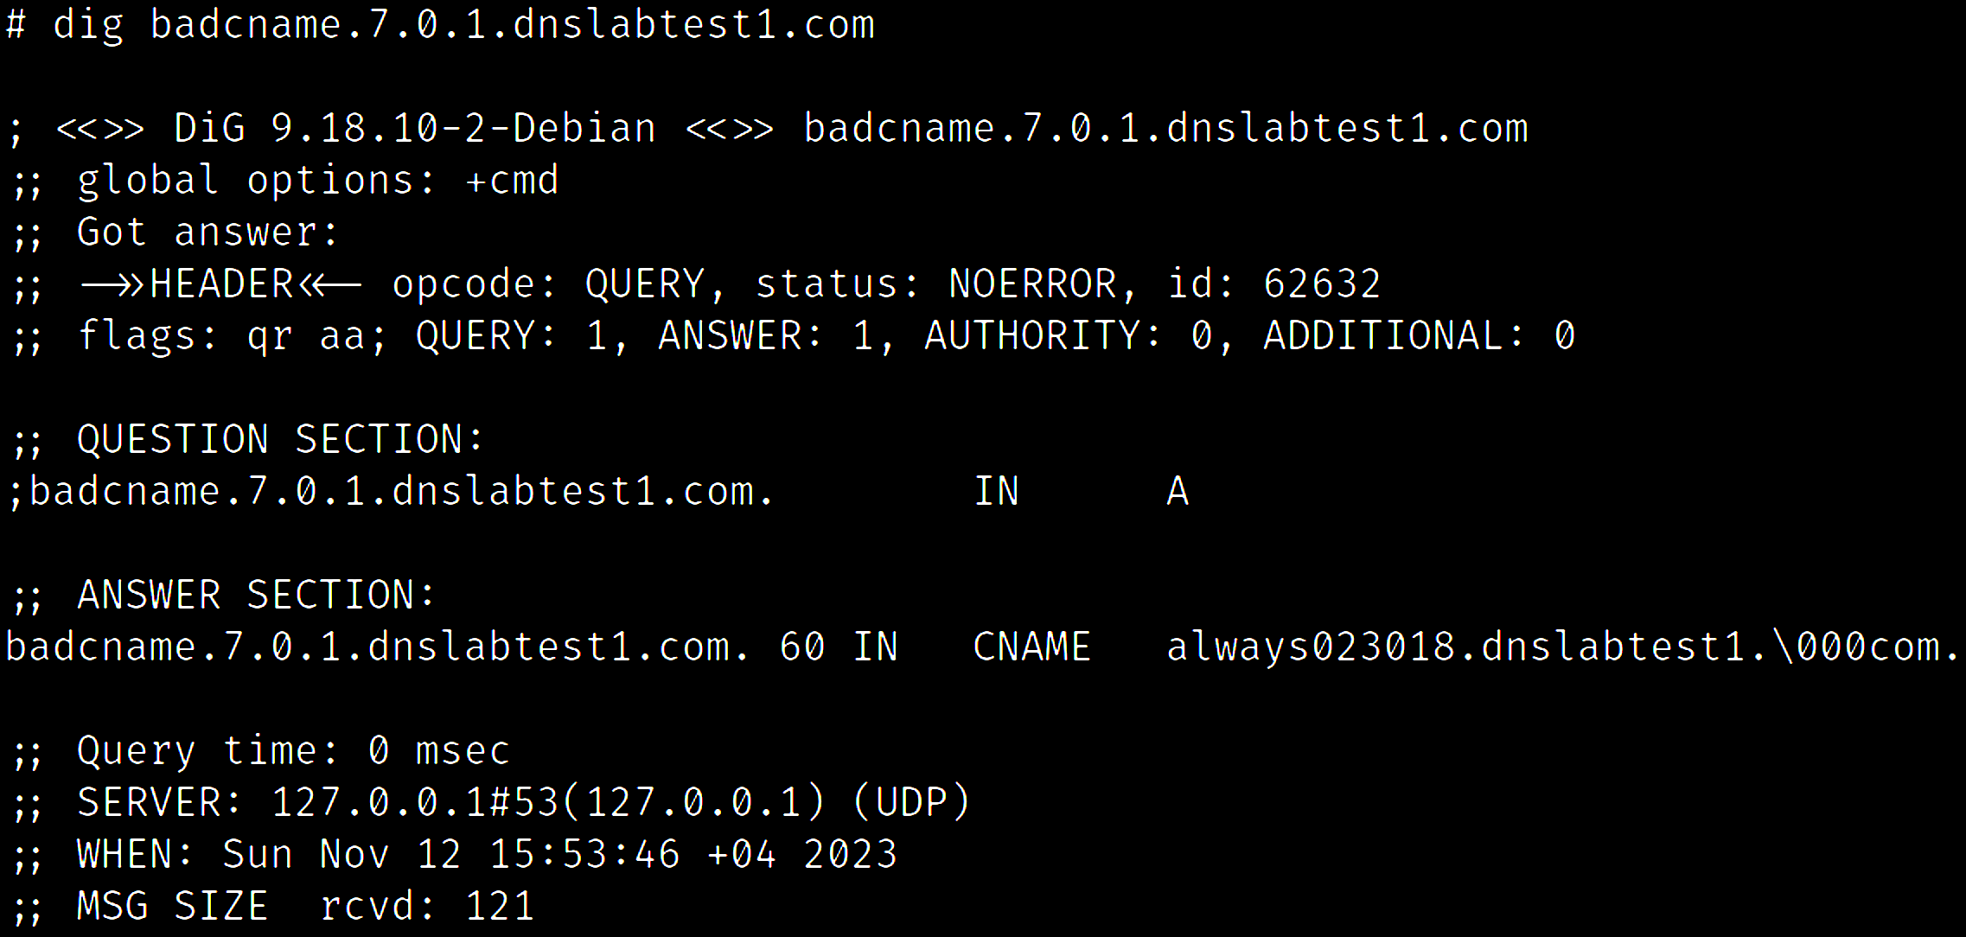
DOMAIN NAMES CONTAINING ILLEGAL CHARACTERS

Slide 76

DOMAIN NAMES CONTAINING ILLEGAL CHARACTERS

Slide 77

DOMAIN NAMES CONTAINING ILLEGAL CHARACTERS

Slide 78
RESPONSE MODIFIERS

Slide 79
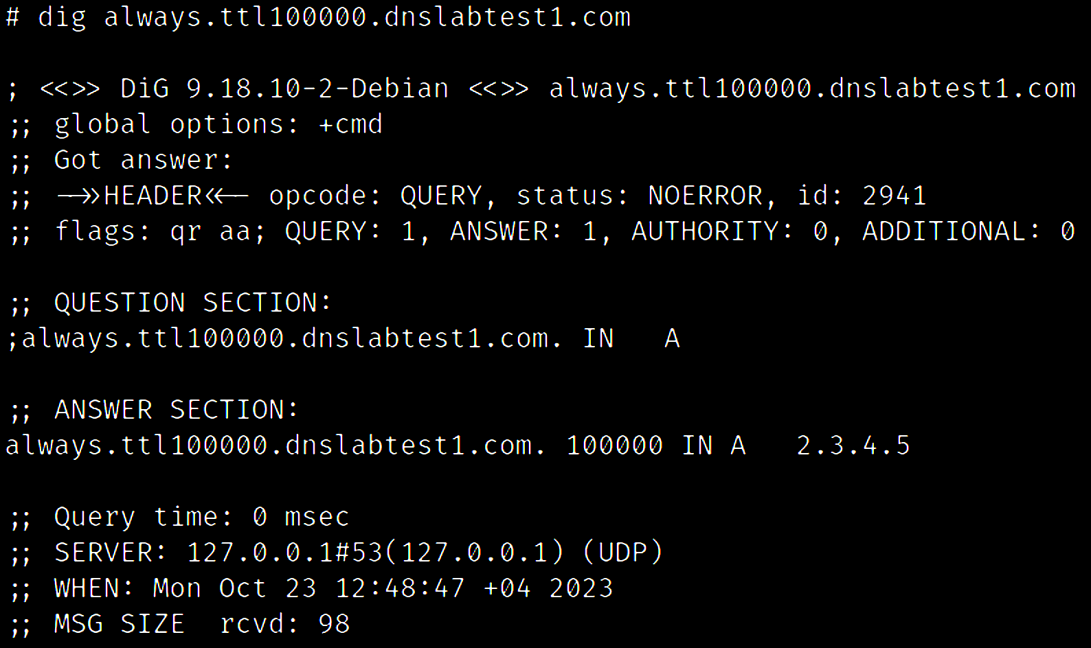
SET ARBITRARY TIME-TO-LIVE (TTL)

Slide 80
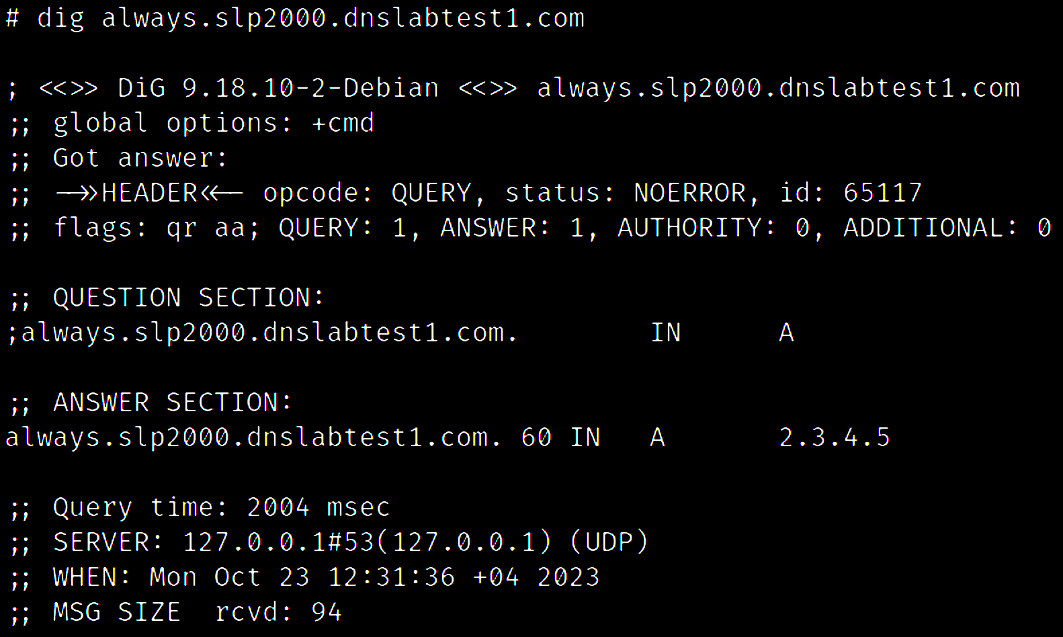
ADD DELAY / LATENCY

Slide 81
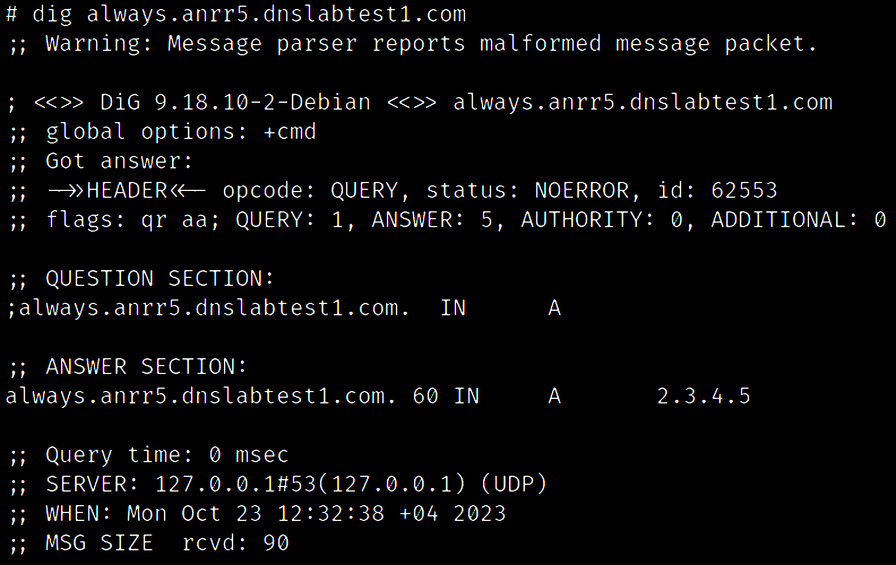
CHANGE NUMBER OF ANSWERS IN DNS HEADER

Slide 82
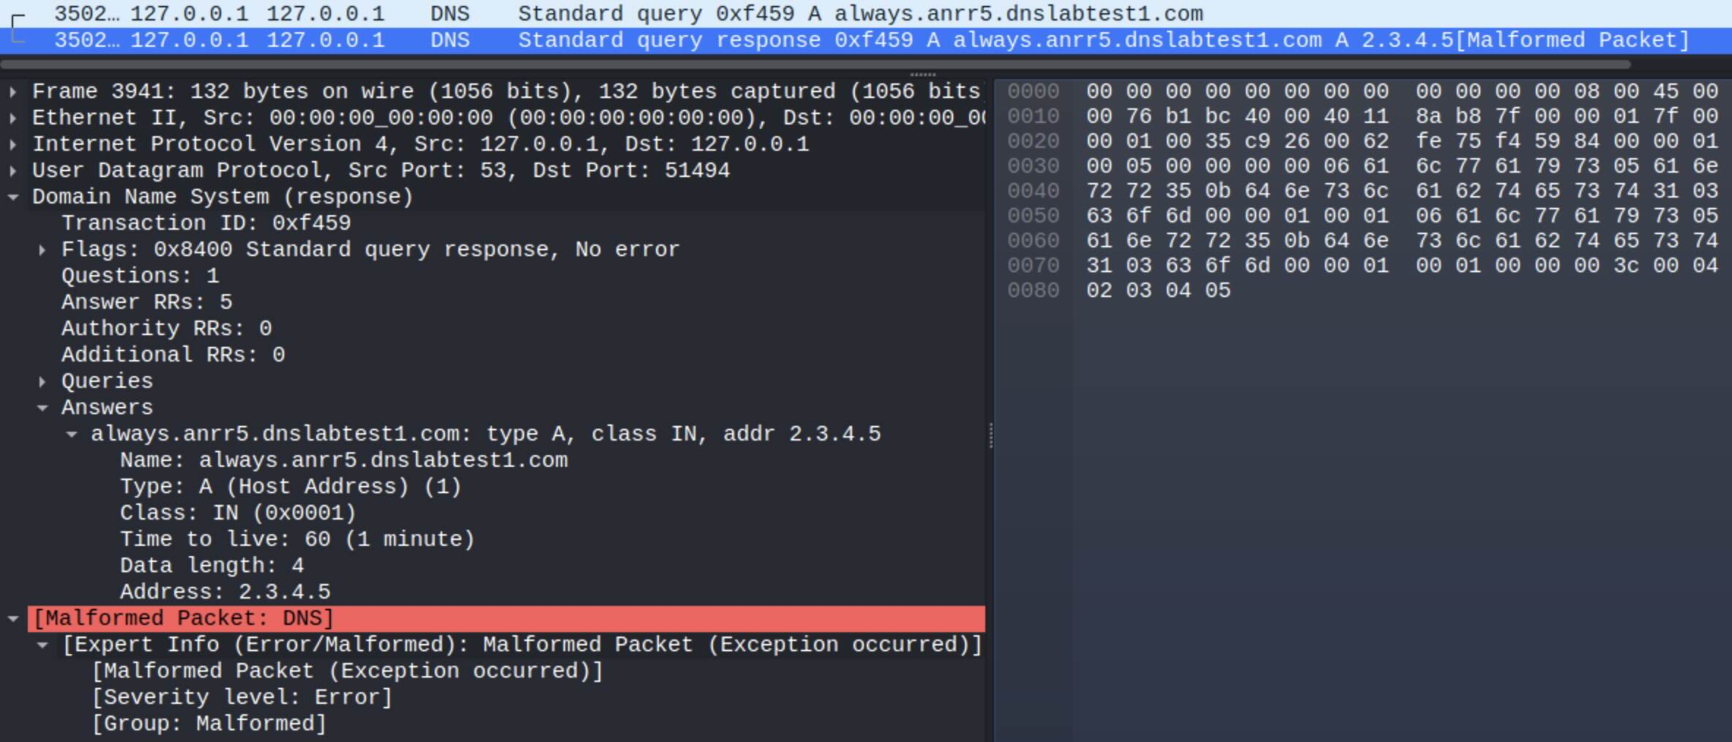
CHANGE NUMBER OF ANSWERS IN DNS HEADER

Slide 83
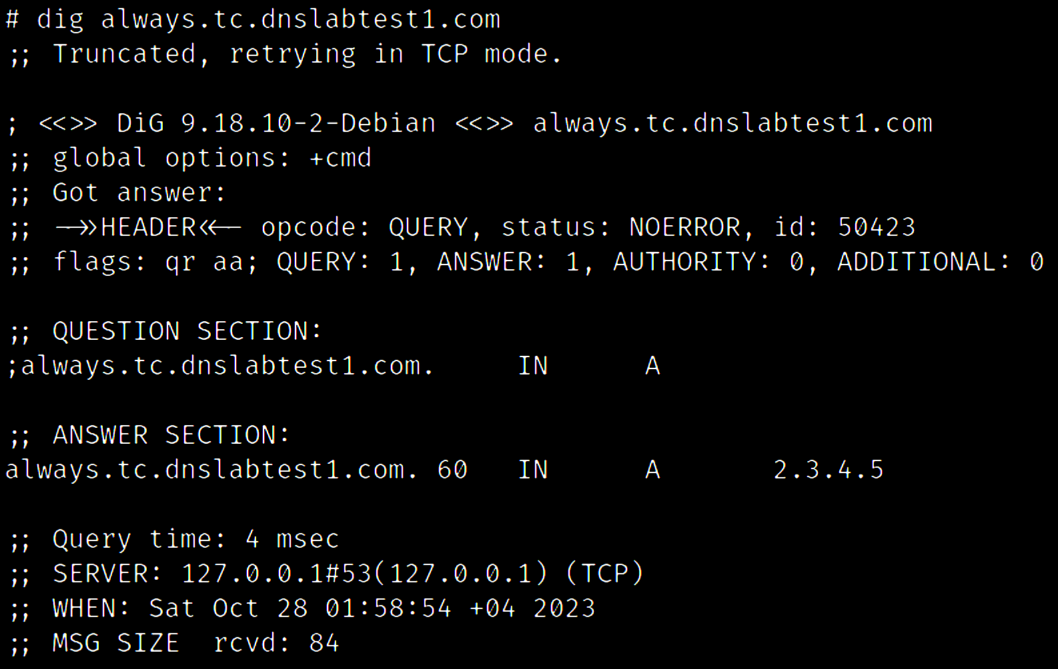
FORCE TCP MODE

Slide 84

FORCE TCP MODE
Dig asks in UDP
PolarDNS responds with TC flag
Dig asks again in TCP
PolarDNS responds in TCP

Slide 85




DNS PACKETS – UDP vs. TCP
UDP TCP

Slide 86

SET ARBITRARY LENGTH (TCP)

Slide 87

SET ARBITRARY LENGTH (TCP)
i g n o r e d .

Slide 88

COMBINING MODIFIERS TOGETHER

Slide 89

ADDITIONAL MODIFIERS
Response modifiers are:
Universal
Feature-agnostic
Combinable

Slide 90
FUN WITH TRANSACTION IDs

Slide 91

TYPICAL DNS QUERY AND A RESPONSE
Transaction ID in the response must match the ID in the query

Slide 92

TYPICAL DNS QUERY AND A RESPONSE
8.8.8.8
DNS query
example.com
2.
ID: 0x1234
DNS resolver
Authoritative DNS server
NS1
DNS response
3.
ID: 0x1234
Authoritative DNS server
NS2
DNS query
ID: 0x6d1a
HELLO
1.
4.
DNS response
ID: 0x6d1a
Client

Slide 93
MISMATCHING TRANSACTION IDs
PolarDNS server has ability to replace the transaction ID in the response with a new random transaction ID
Include the ‘newid’ response modifier in the domain name e.g.:
anything.whatever.newid.attacker.com

Slide 94
MISMATCHING TRANSACTION IDs
8.8.8.8
DNS query
attacker.com
2.
ID: 0x1234
DNS resolver
NS1
DNS response
3.
?
ID: 0x1234
NS2
DNS query
ID: 0x5678
ID: 0x6d1a
1.
4.
The DNS resolver should not accept this response (3.)
?
Client

Slide 95

ID MISMATCH TEST
Ok, expected

Slide 96

ID MISMATCH TEST – GOOGLE DNS
Ok, expected

Slide 97

ID MISMATCH TEST – OPENDNS
Ok, expected

Slide 98

ID MISMATCH TEST – CLOUDFLARE DNS
???

Slide 99


LET’S ASK VARIOUS PUBLIC DNS RESOLVERS

Slide 100

ID MISMATCH TEST – ADGUARD DNS
???

Slide 101


MISMATCHING TRANSACTION IDs
CloudFlare and AdGuard do not care about transaction IDs at all !
Why is it important?

Slide 102
DNS CACHE POISONING
DNS CACHE POISONING
A caching DNS resolver is prone to cache poisoning if:
It uses predictable source ports (0-65535 / 16 bits)
It uses predictable transaction IDs (0-65535 / 16 bits)
Altogether, these 32 bits of supposedly random data present a complexity of 4,294,967,296 possible combinations (*).
==> VERY HARD / IMPOSSIBLE TO POISON
* Assuming the resolver is not using 0x20 encoding, DNS cookies etc.

Slide 103
DNS CACHE POISONING ON CLOUDFLARE AND ADGUARD
DNS CACHE POISONING
A caching DNS resolver is prone to cache poisoning if:
It uses predictable source ports (0-65535 / 16 bits)
It uses predictable transaction IDs (0-65535 / 16 bits)
Complexity is reduced to 65,536 possible combinations.
==> MUCH EASIER TO DO POISONING
Dan Kaminsky attack (2008)

Slide 104


BUG BOUNTY ON
DNS CACHE POISONING

Slide 105
DNS RECORD INJECTIONS

Slide 106

DNS RECORD INJECTIONS
inj03.dnslabtest1.com

Slide 107

DNS RECORD INJECTIONS

Slide 108
DNS RECORD INJECTIONS

Slide 109

DNS RECORD INJECTIONS

Slide 110
DNS RECORD INJECTIONS

Slide 111

DNS RECORD INJECTIONS

Slide 112

DNS RECORD INJECTIONS

Slide 113

DNS RECORD INJECTIONS

Slide 114
DNS RECORD INJECTIONS
Is the target resolver going to learn the injected information?
Ask if the injected record has been cached:
Unlikely to work, but an important test
14 different injection scenarios in many variants:
Injecting a 3rd party domain information
Replacing the question in the QUERY section
Adding a question in the QUERY section

Slide 115

DNS RECORD INJECTIONS

Slide 116
DNS RECORD INJECTIONS

Slide 117
EMPTY AND INCOMPLETE RESPONSES

Slide 118

DNS RECORD INJECTIONS
SENDING BACK AN EMPTY PACKET
empty1.dnslabtest1.com

Slide 119

SENDING BACK AN EMPTY PACKET
Sending back empty packet

Slide 120

SENDING BACK AN EMPTY PACKET
Potential DoS trigger

Slide 121

SENDING BACK NULL BYTES (\x00)
Sending back 10 NULL bytes

Slide 122

SENDING BACK NULL BYTES (\x00)
Potential DoS trigger

Slide 123

SENDING BACK NULL BYTES (\x00) IN TCP
Respond by sending back 10 NULL bytes in TCP mode

Slide 124

SENDING BACK NULL BYTES (\x00) IN TCP
Potential DoS trigger

Slide 125

SENDING BACK NULL BYTES (\x00) WITH PROPER TXID
???

Slide 126

SENDING BACK NULL BYTES (\x00) WITH PROPER TXID
Potential DoS trigger

Slide 127
OTHER VARIANTS OF EMPTY RESPONSES
NULLs + proper TXID + ANSWER RR => 1
ANSWER body missing
ANSWER body replaced with NULLs
Send back the same query (query reflection)
Send back the same query (query reflection) to UDP port 53
Just close the connection
Abandon the connection (timeout)

Slide 128


SENDING BACK NULL BYTES (\x00) – KNOT RESOLVER
This is expected, but let’s see the PolarDNS console ..

Slide 129

SENDING BACK NULL BYTES (\x00) – KNOT RESOLVER
Timestamp | Source IP + port | ID | Incoming query | Our response
Knot Resolver is connecting to us very rapidly
It made nearly a 100 connections
Could be potentially abused as DoS
CVE-2023-46317

Slide 130
ADDING NEW FEATURES

Slide 131
ADDING NEW FEATURES TO
Adding new features to PolarDNS can help you identify new and original bugs
It is relatively easy, once you get familiar with it
All you need is some programming experience and knowing a bit of DNS

Slide 132
ADDING NEW FEATURES TO
Steps to add new features to PolarDNS:
Edit the polardns.py file
Make a copy of a similar scenario
Modify your scenario
Test the functionality locally with dig , nslookup etc.
(Recommended) Run tests
Upload to your nameservers

Slide 133

ADDING NEW FEATURES TO
1.
2.
3.
4.

Slide 134
ADDING NEW FEATURES TO
Flags = Standard response
# Questions = Taken from the query (1)
# Answer RRs = 1
# Authority RRs = 0
# Additional RRs = 0
1.

Slide 135
ADDING NEW FEATURES TO
Requested domain (“always.attacker.com”)
Requested Type (“A”)
Requested Class (“IN”)
2.

Slide 136
ADDING NEW FEATURES TO
Requested domain (“always.attacker.com”)
Type (“A”)
3.
Class (“IN”)
TTL (default is 60)
IPv4 length is 4 bytes
IPv4 (2.3.4.5)

Slide 137
ADDING NEW FEATURES TO
4.

Slide 138
ADDING NEW FEATURES TO
Wireshark is your best friend here to help you with the DNS protocol. You’ll be a PRO in no time!
Useful links about DNS record types and their parameters:
https://en.wikipedia.org/wiki/List_of_DNS_record_types
https://www.iana.org/assignments/dns-parameters/dns-parameters.xhtml

Slide 139
CONCLUSION

Slide 140
CONCLUSION
With you can engage in DNS vulnerability research
DNS is very complex, but not hard to work with. is here to help you
Looking into DNS can be rewarding. There could be low hanging fruit.
Don’t be evil!
Be nice

Slide 141
THANK YOU

Slide 142
BONUS SLIDES

Slide 143
TIPS TO FIND MORE BUGS
Get inspiration from existing CVEs related to DNS
Get inspiration from the patches and code fixes
Use PolarDNS locally, experiment, use Wireshark to inspect the traffic
Read DNS related RFCs:
https://en.wikipedia.org/wiki/Domain_Name_System#RFC_documents

Slide 144
OTHER EXAMPLES & NOTABLE USE-CASES

Slide 145


DOMAIN NAMES CONTAINING ILLEGAL CHARACTERS

Slide 146

DOMAIN NAMES CONTAINING ILLEGAL CHARACTERS

Slide 147

DOMAIN NAMES CONTAINING ILLEGAL CHARACTERS

Slide 148

DOMAIN NAMES CONTAINING ILLEGAL CHARACTERS

Slide 149

DOMAIN NAMES CONTAINING ILLEGAL CHARACTERS

Slide 150

DOMAIN NAMES CONTAINING ILLEGAL CHARACTERS
We got malformed DNS packet.
Why?

Slide 151
DOMAIN NAMES CONTAINING ILLEGAL CHARACTERS
67
11
3
55
83
RFC 1035 section 2.3.4 dictates the following 2 limitations with regards to domain name lengths:
A label (a single domain component) length must not exceed 63 bytes
A domain name length must not exceed 255 bytes in total
This is the problem.
No problem here.

Slide 152

DOMAIN NAMES OF ILLEGAL LENGTHS
bigcname.dnslabtest1.com

Slide 153

DOMAIN NAMES OF ILLEGAL LENGTHS
size
size
size

Slide 154

DOMAIN NAMES OF ILLEGAL LENGTHS

Slide 155

DOMAIN NAMES OF ILLEGAL LENGTHS

Slide 156

DOMAIN NAMES OF ILLEGAL LENGTHS
manylabels.dnslabtest1.com

Slide 157

DOMAIN NAMES OF ILLEGAL LENGTHS
how many
length

Slide 158

DOMAIN NAMES OF ILLEGAL LENGTHS

Slide 159

DOMAIN NAMES OF ILLEGAL LENGTHS

Slide 160

DOMAIN NAMES OF ILLEGAL LENGTHS

Slide 161
OTHER ILLEGAL DOMAIN NAMES

Slide 162
DOMAIN NAMES CONTAINING ILLEGAL CHARACTERS
Interesting characters to experiment with:
00 (NUL) null byte
10 (\n) new line
13 (\r) carriage return
32 ( ) space
46 (.) period
92 (\) backslash
34 (“) quotes
39 (‘) single quote
42 (*) asterisk
58 (: ) colon
64 (@) at sign

Slide 163

ILLEGAL CNAME ALIASES
URL as alias?

Slide 164

ILLEGAL CNAME ALIASES
Port number in alias?

Slide 165

ILLEGAL CNAME ALIASES
IP address as alias???

Slide 166

ILLEGAL CNAME ALIASES
The IP address is written as 4 labels in the DNS name notation format
This is NOT how IP addresses are transmitted over the network

Slide 167

ILLEGAL CNAME ALIASES
This is how IP addresses are transmitted over the network
IPv4 address is simply 4 bytes

Slide 168

ILLEGAL CNAME ALIASES
IP address with actual dots as alias???

Slide 169

ILLEGAL CNAME ALIASES
The IP address is written as a single label in the DNS name notation format
Also using period symbols (.) in ASCII
Definitely NOT how IP addresses are transmitted over the network

Slide 170
BAD COMPRESSION

Slide 171

DNS COMPRESSION

Slide 172

DNS COMPRESSION
c0 = compression
Next byte (0c) is the offset from the beginning of the DNS packet referencing another string object.
0c = 12
It points to the first occurrence of “yahoo.com” string.

Slide 173
BAD DNS COMPRESSION
PolarDNS has multiple features related to compression which allow you for example:
Create compression loops (referencing to self, referencing to another string which references back)
Manipulate the compression offsets in different fields
Could lead to malformations and DoS issues

Slide 174

BAD DNS COMPRESSION
Malformed packet

Slide 175

BAD DNS COMPRESSION – VARIANT 1

Slide 176

BAD DNS COMPRESSION – VARIANT 2

Slide 177

BAD DNS COMPRESSION – VARIANT 3

Slide 178
THANK YOU

